Slide 1
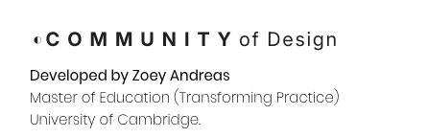
Accessibility Design Challenge

Slide 2
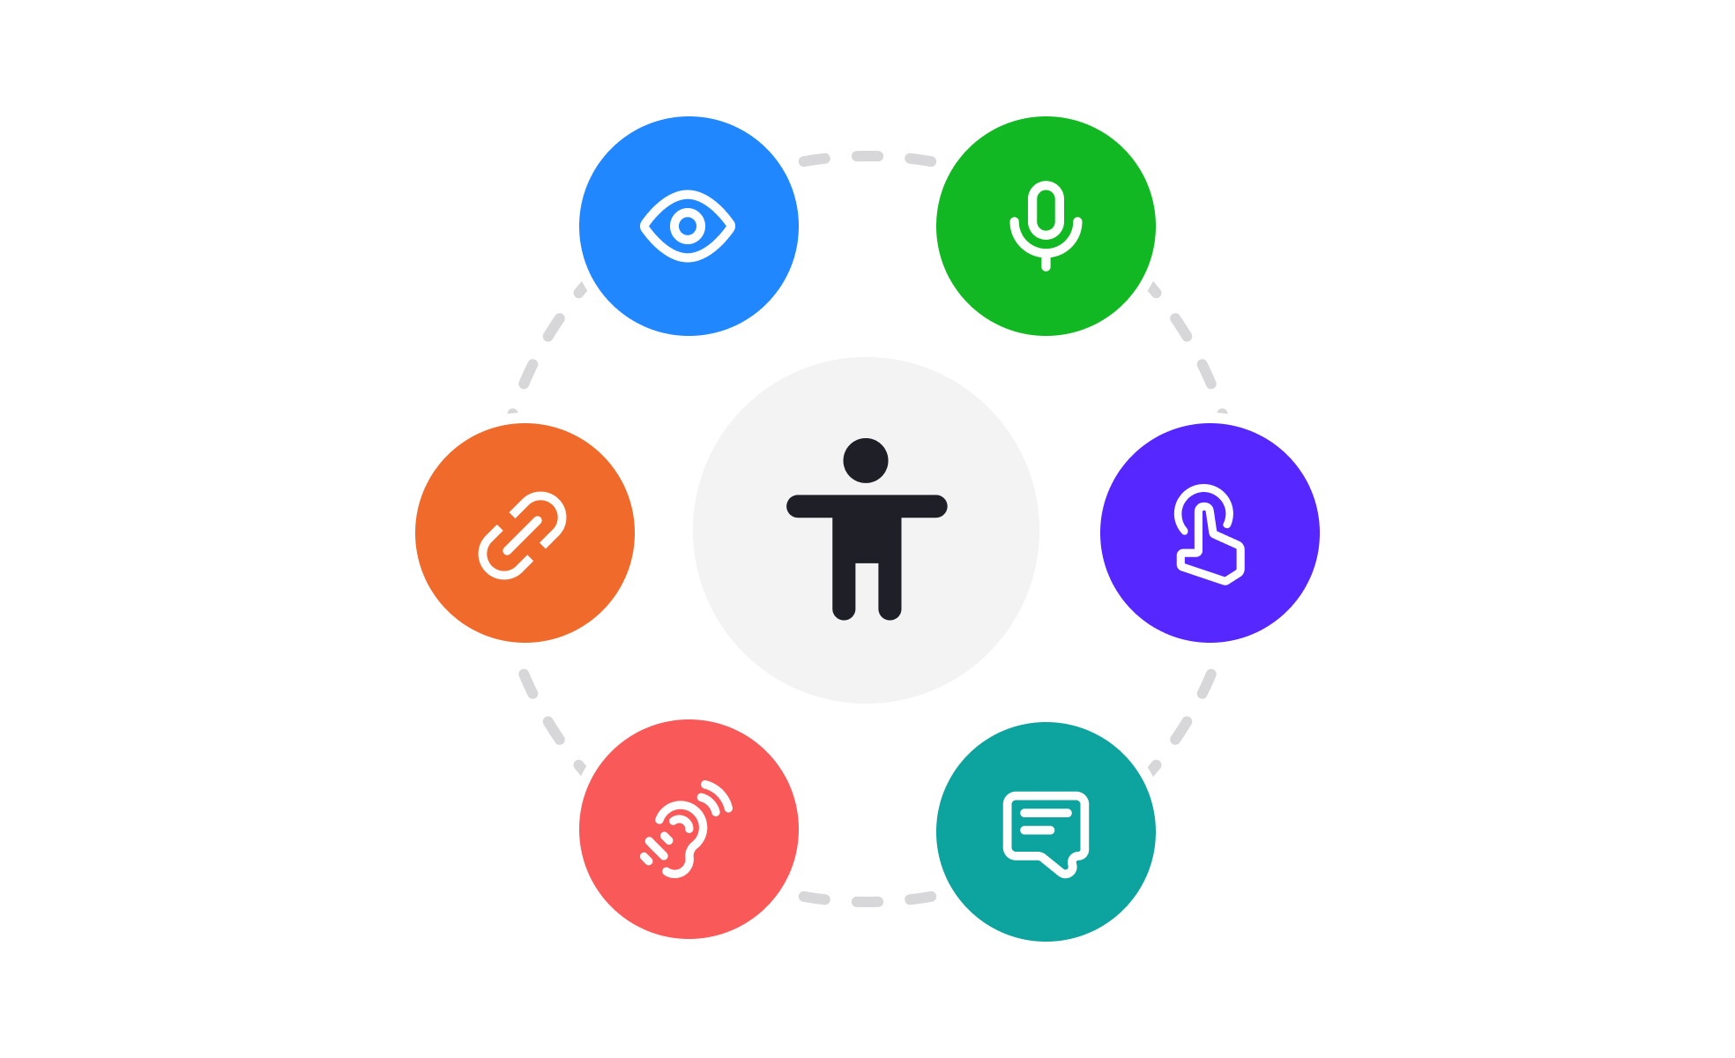

Slide 3


Slide 4
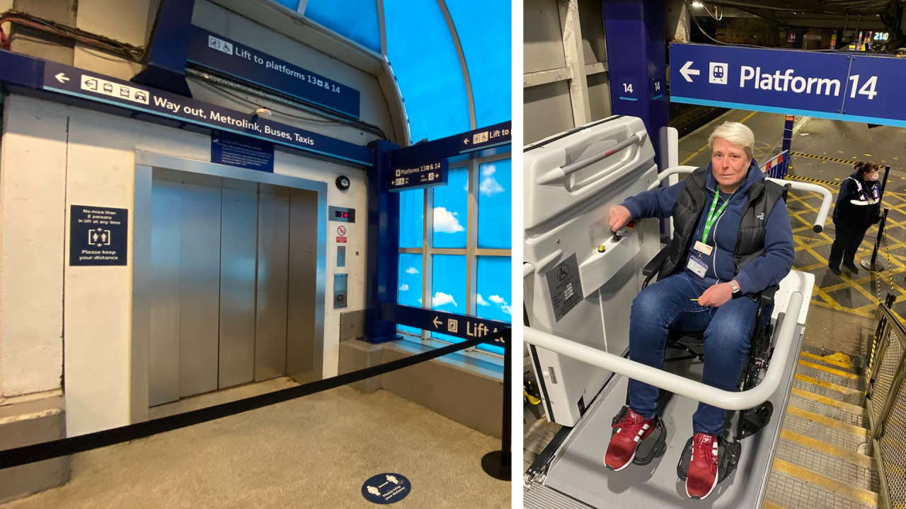

Slide 5
Design something that improves accessibility
for a user with a disability

Slide 6
Problem > Research > Ideas > Prototype > Test > Improve > Share

Slide 7
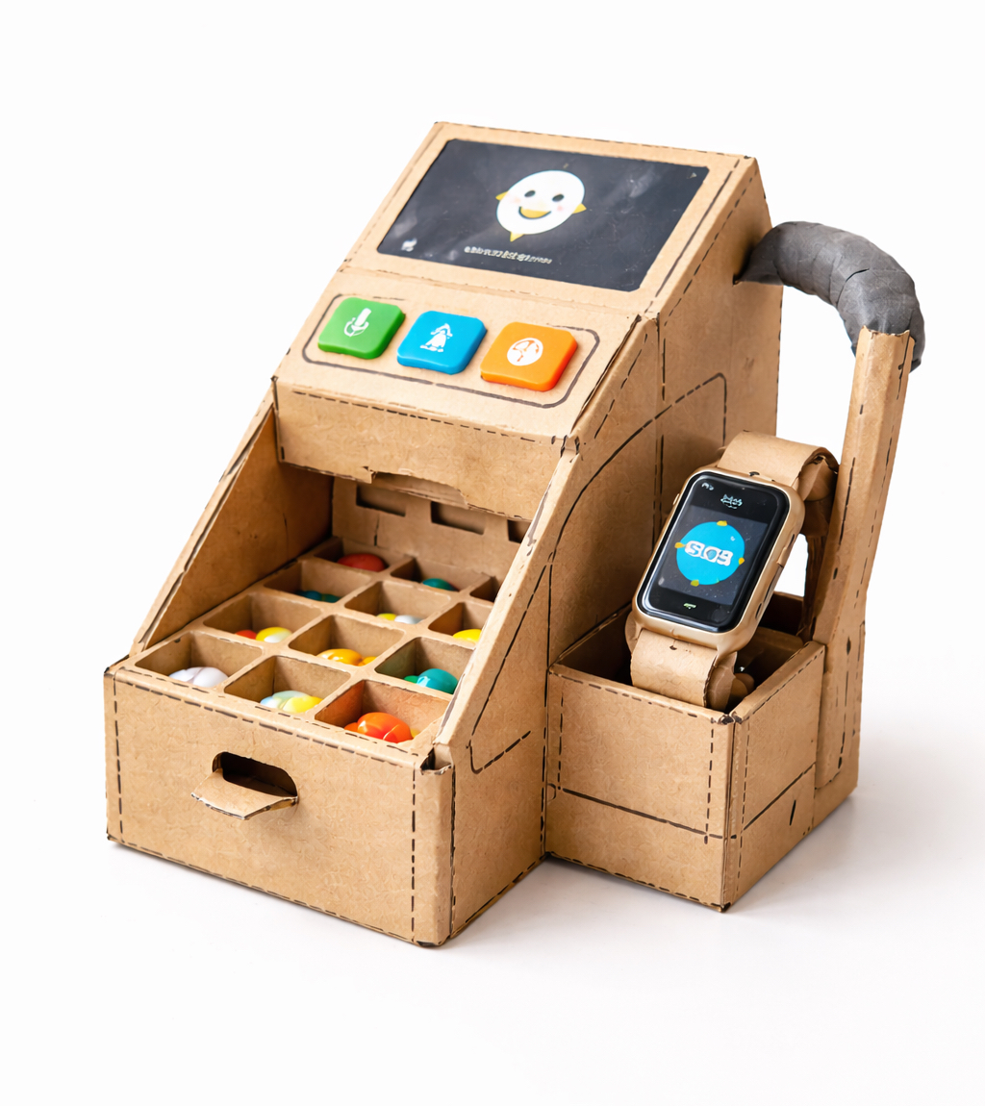
Example prototype

Slide 8
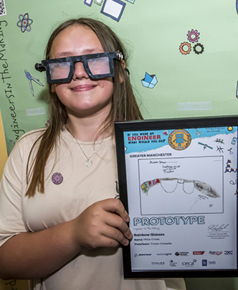
Design example
Year 7 pupil Millie Childs

Slide 9
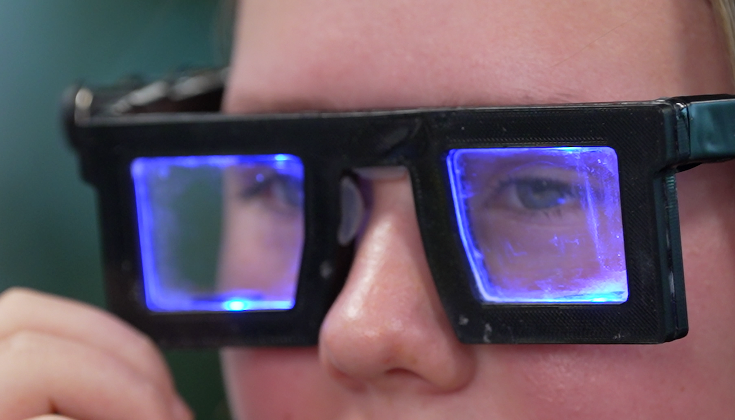
Working Prototype
Glasses designed to help people with dyslexia read more easily

Slide 10
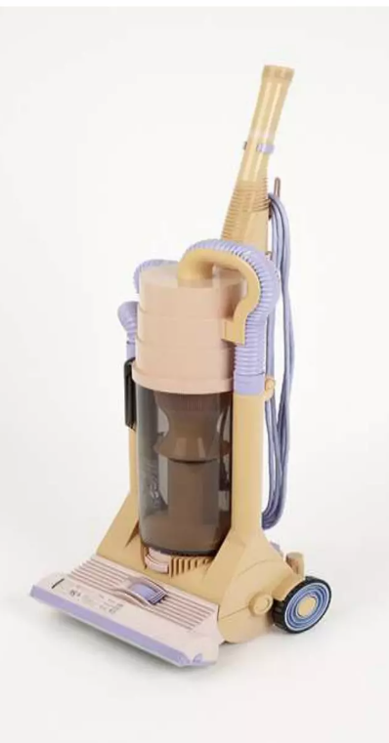
Early Dyson prototype (1993)

Slide 11
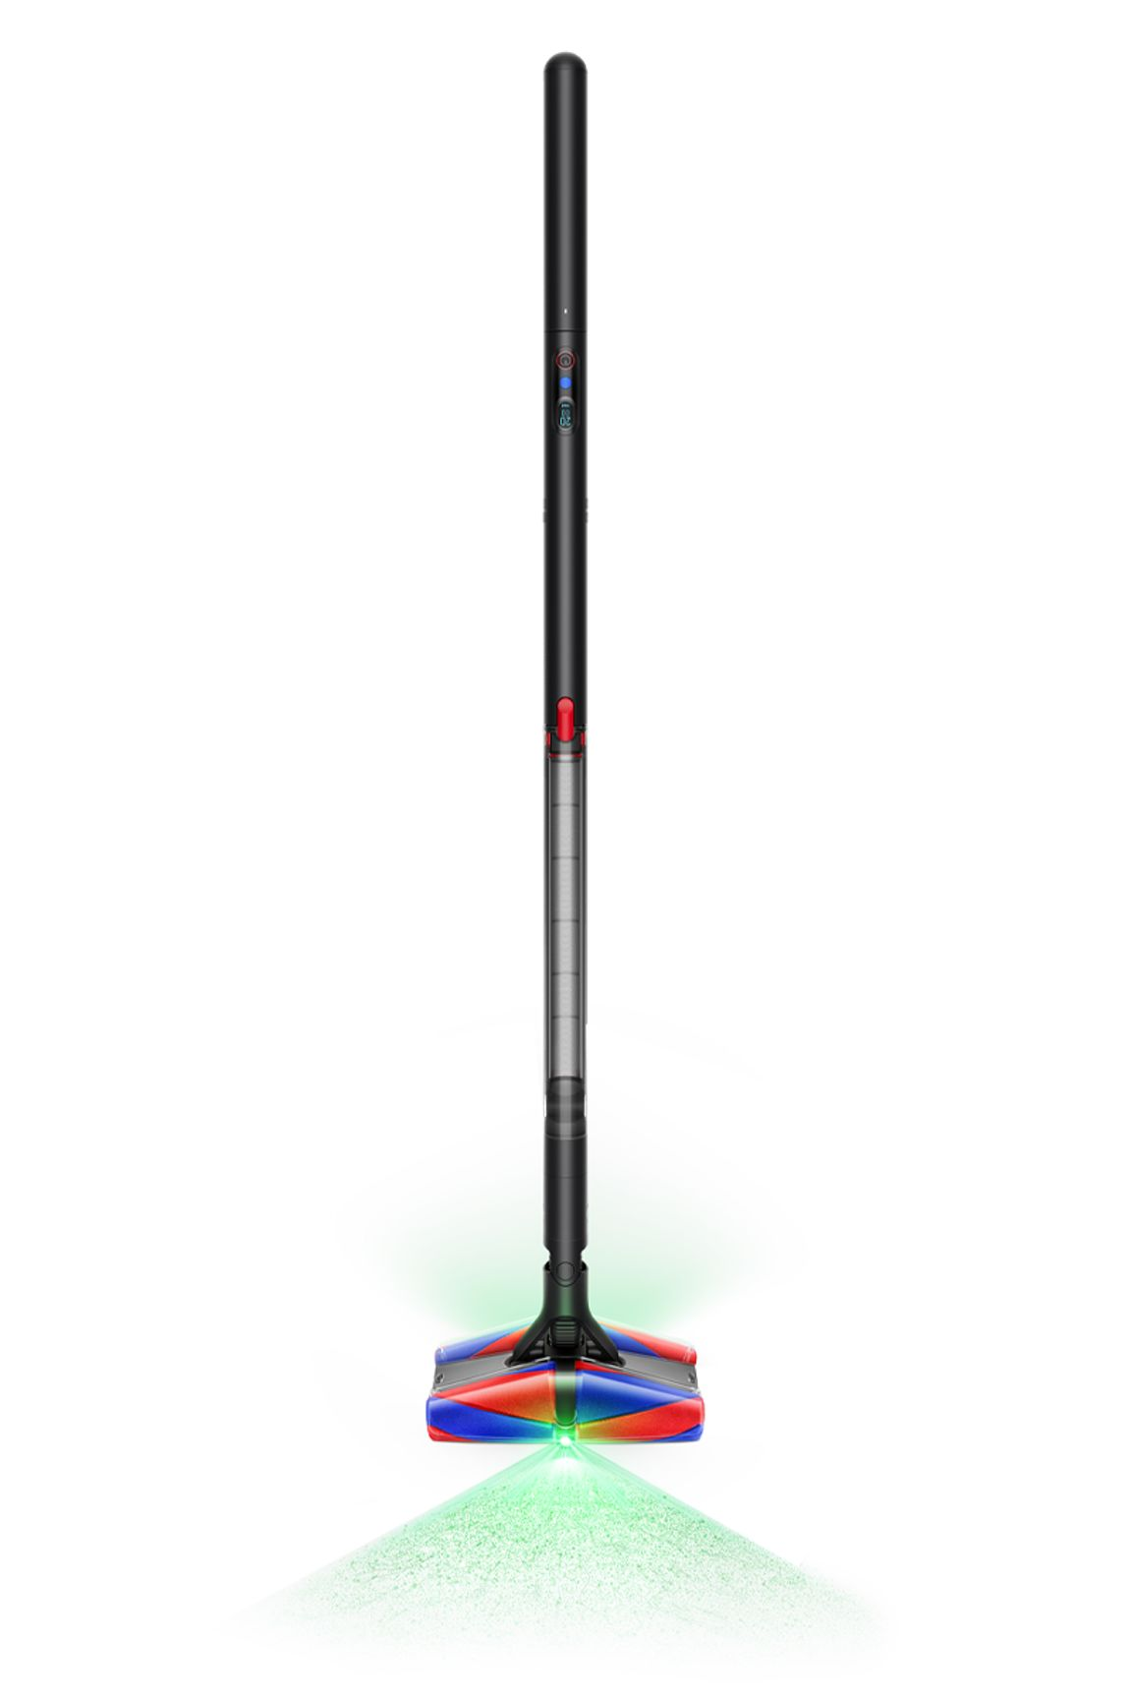
Modern Dyson Design

Slide 12
Dyson built 5,127 prototypes before success

