Slide 1

Future Design Challenge

Slide 2
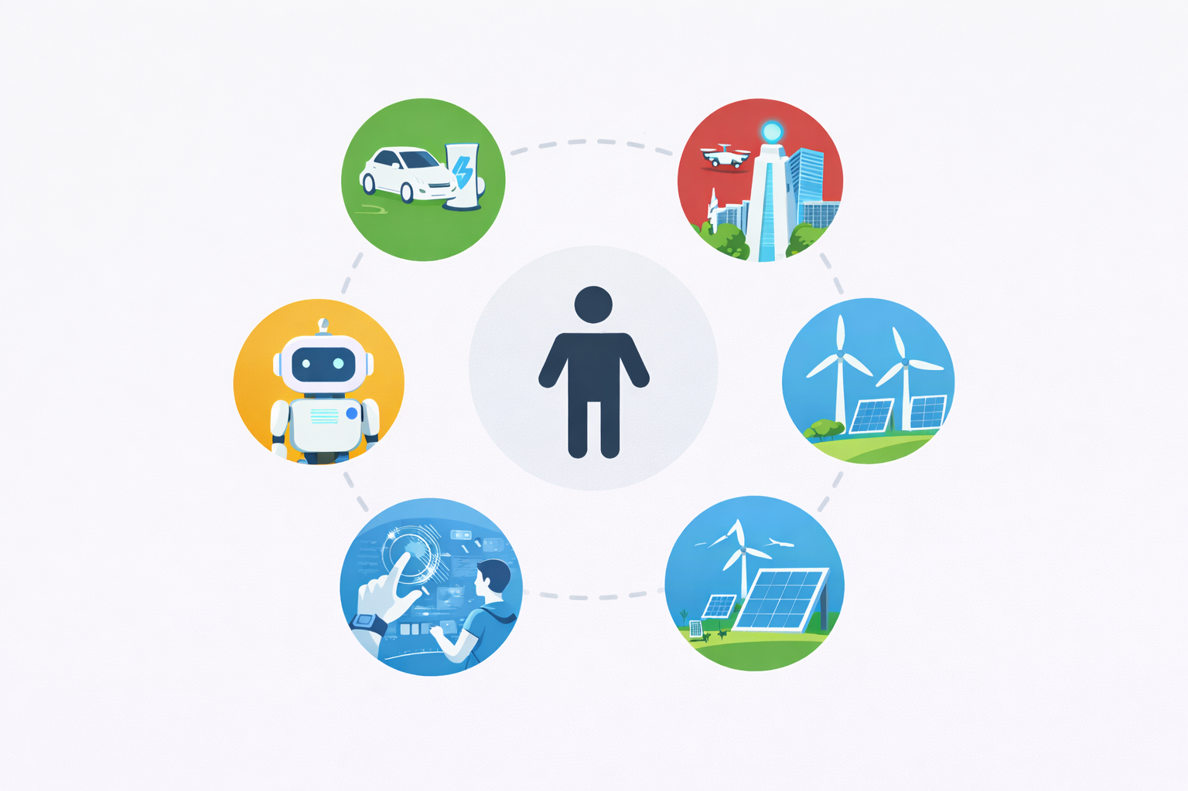

Slide 3


Slide 4
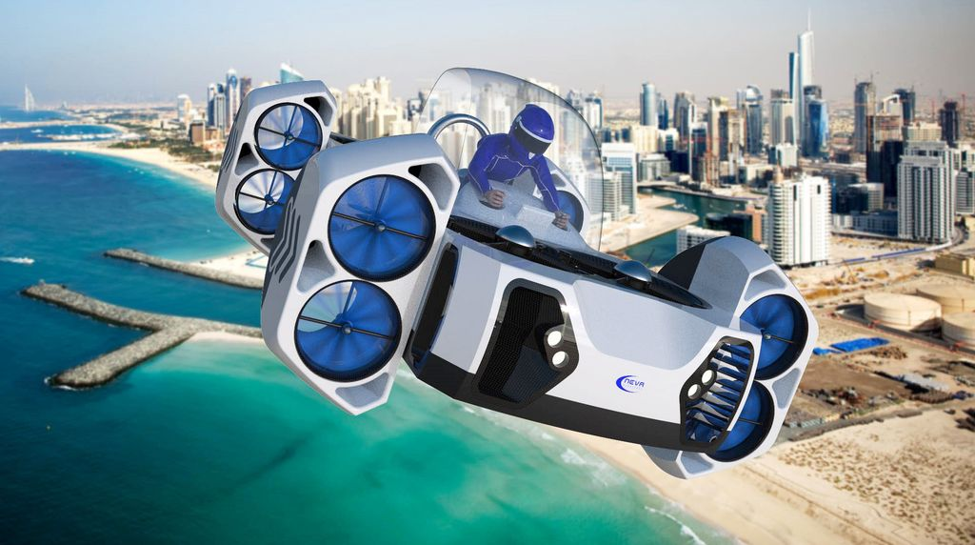

Slide 5
Design something that could improve people's lives in the future

Slide 6
Problem > Research > Ideas > Prototype > Test > Improve > Share

Slide 7
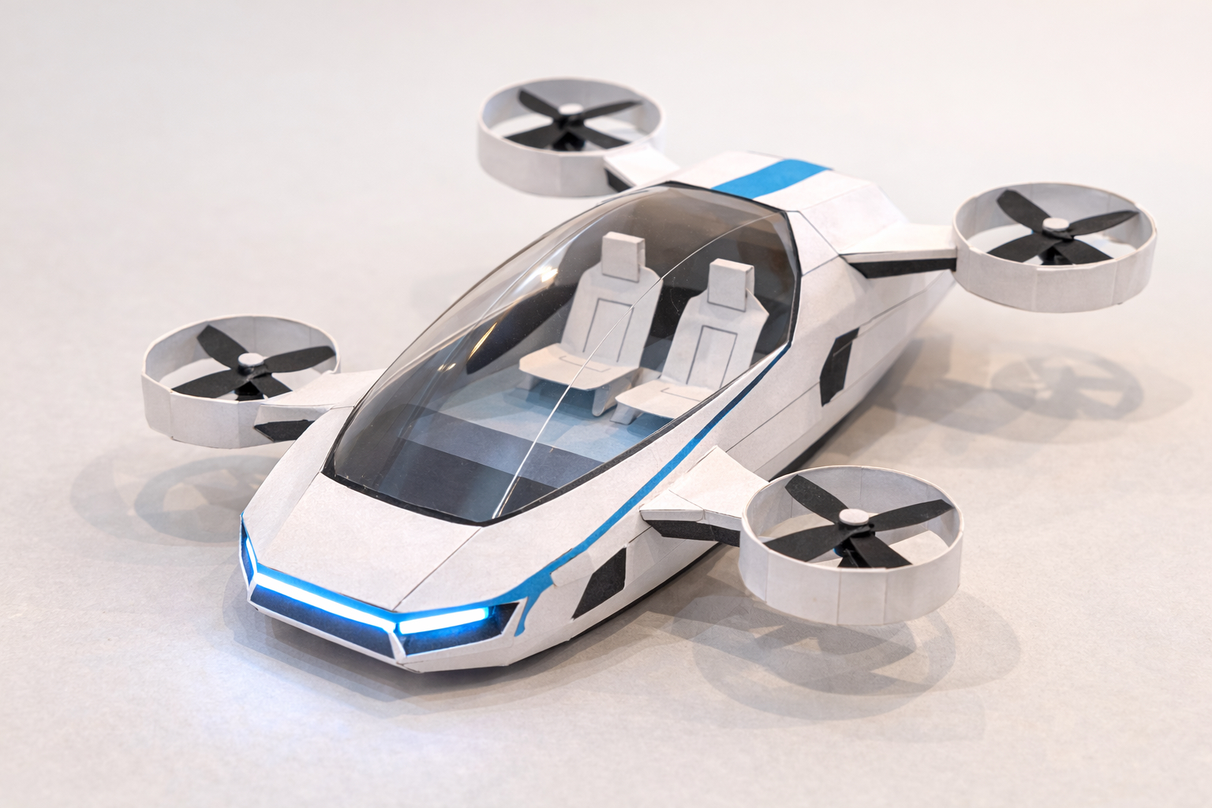
Example prototype

Slide 8
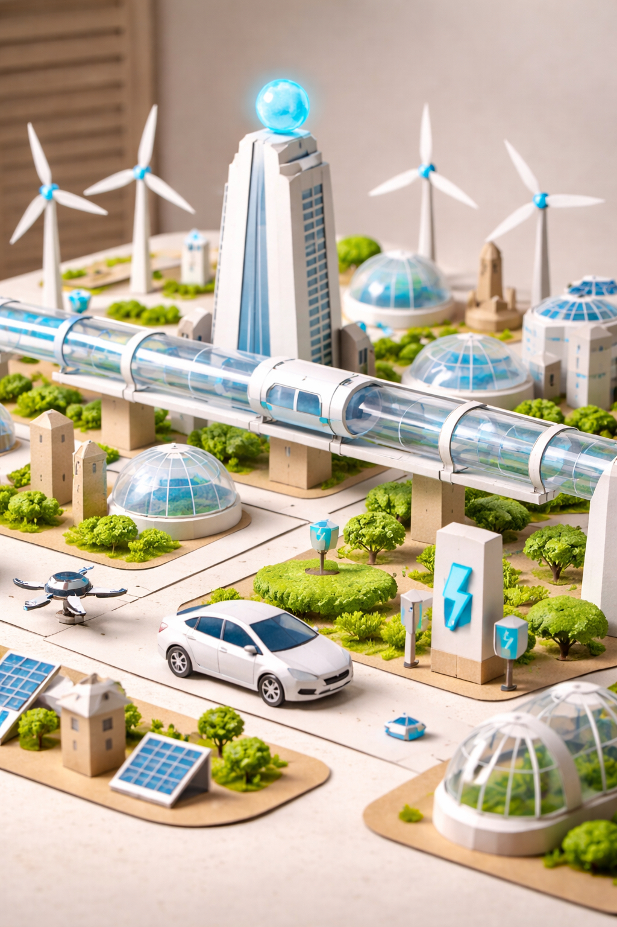
Example prototype

Slide 9
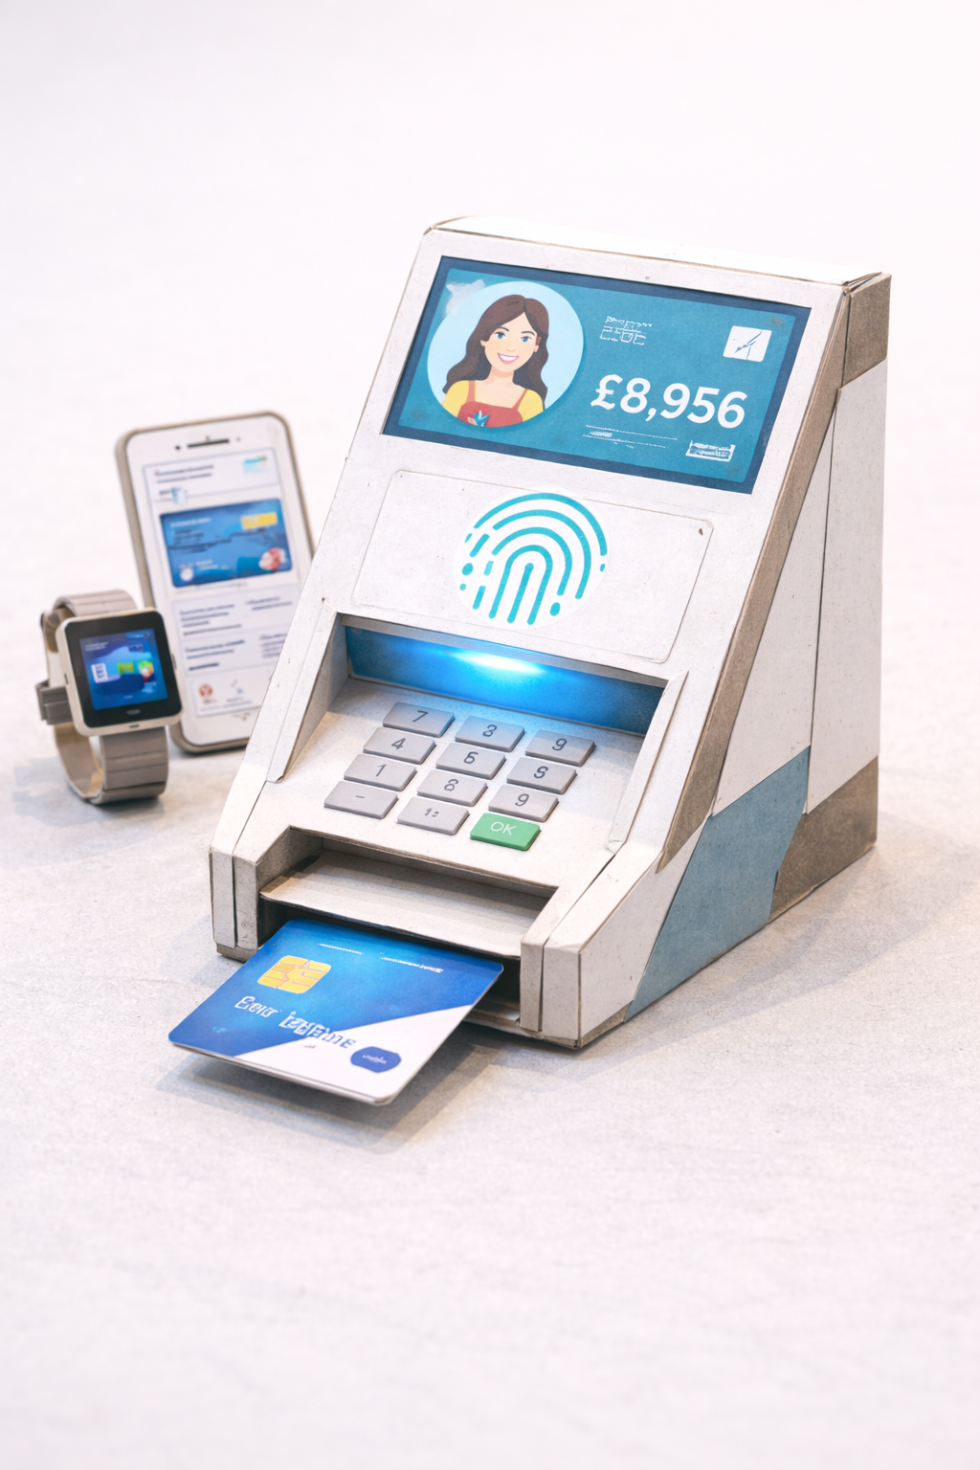
Example prototype

Slide 10
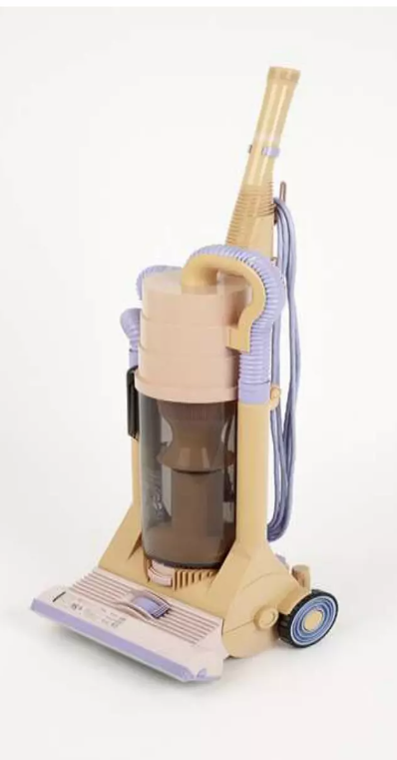
Early Dyson prototype (1993)

Slide 11
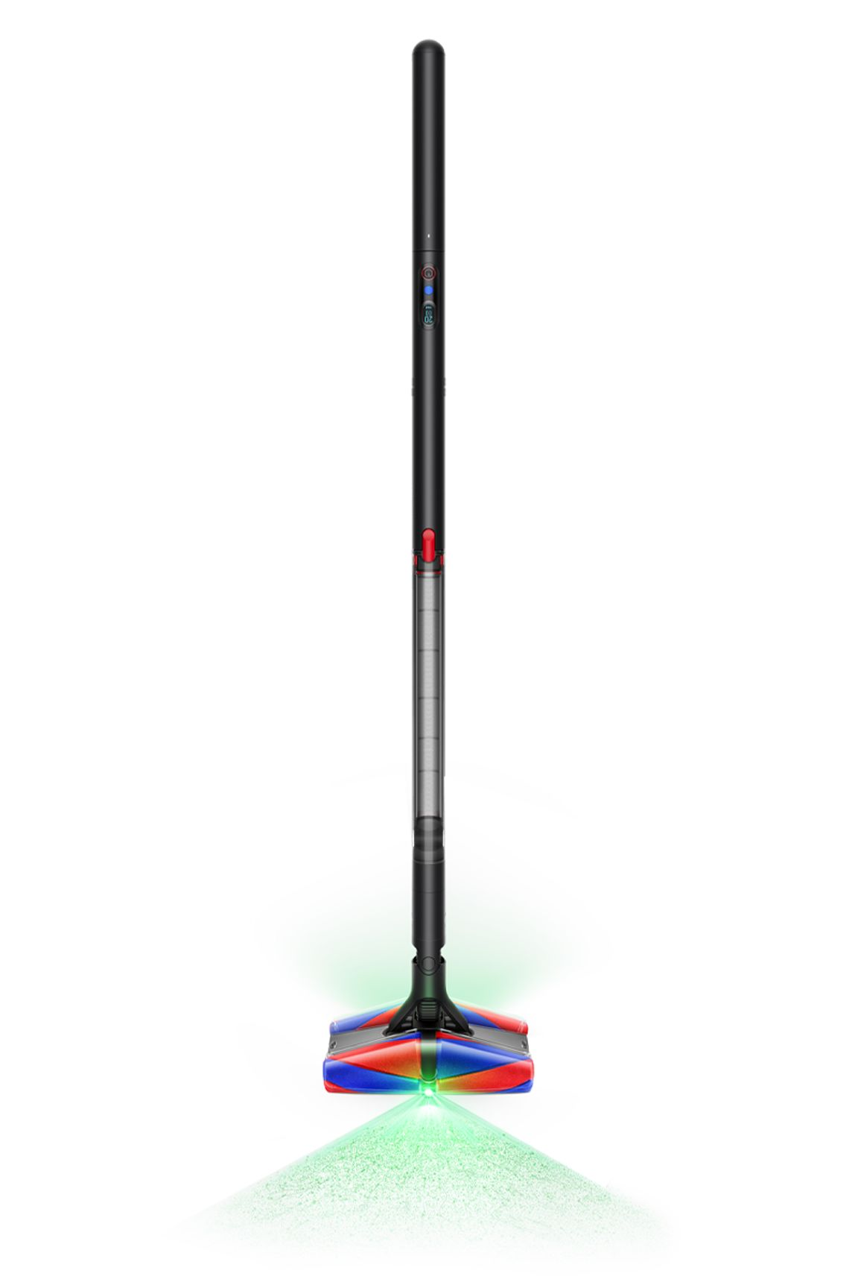
Modern Dyson Design

Slide 12
Dyson built 5,127 prototypes before success

