Slide 1

AI Design Challenge

Slide 2
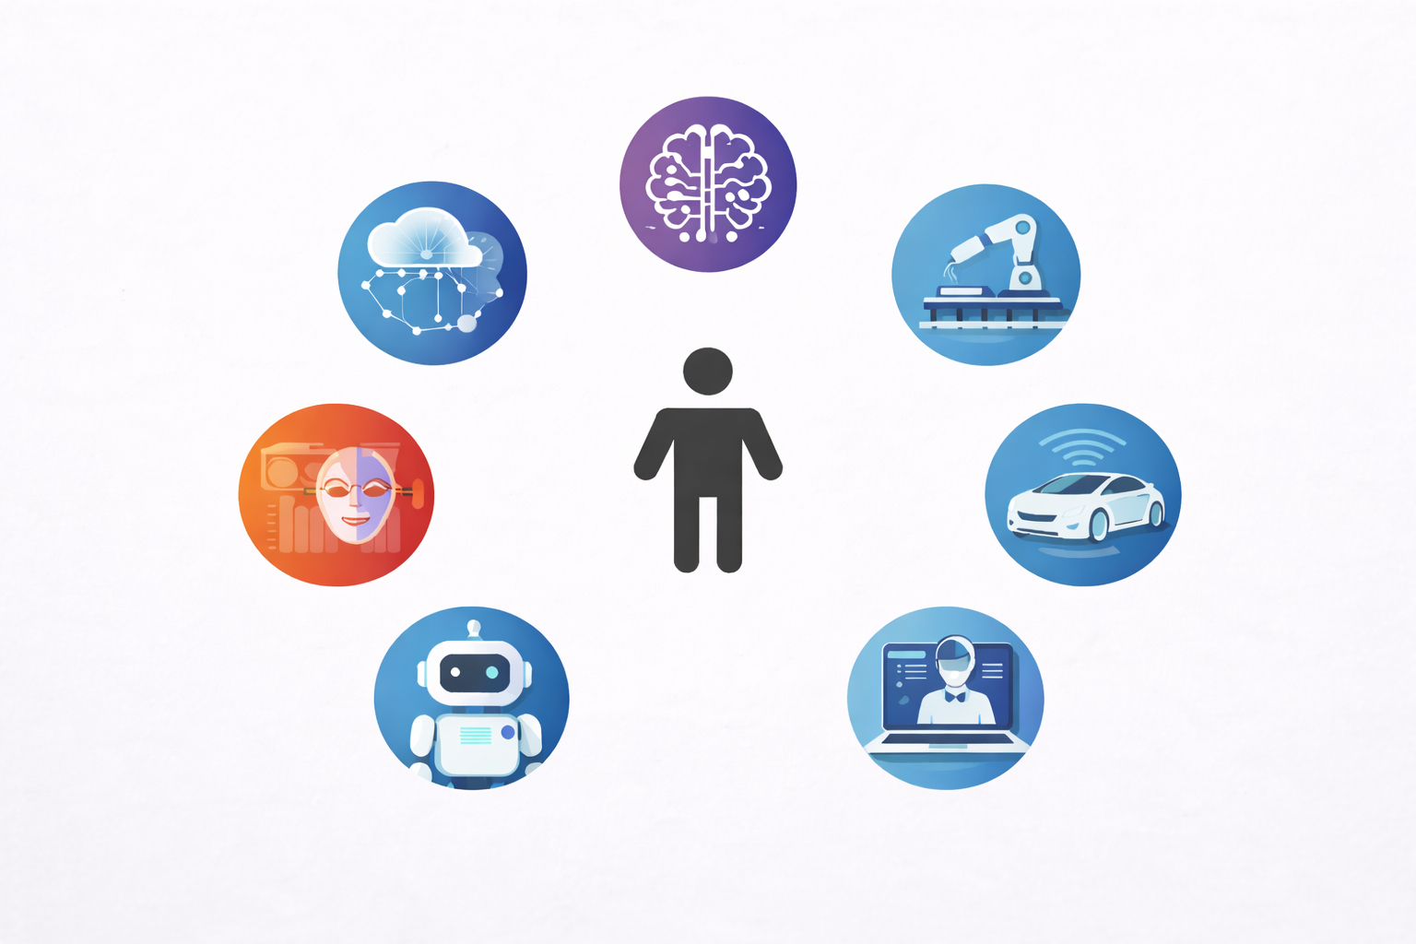

Slide 3
Use AI to help in designing a product, service or system that improves people's lives

Slide 4
Problem > Research > Ideas > Prototype > Test > Improve > Share

Slide 5

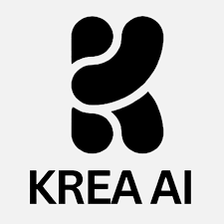






AI Tools Designers Use

Slide 6
AI can help designers generate ideas, images, prototypes and research

Slide 7
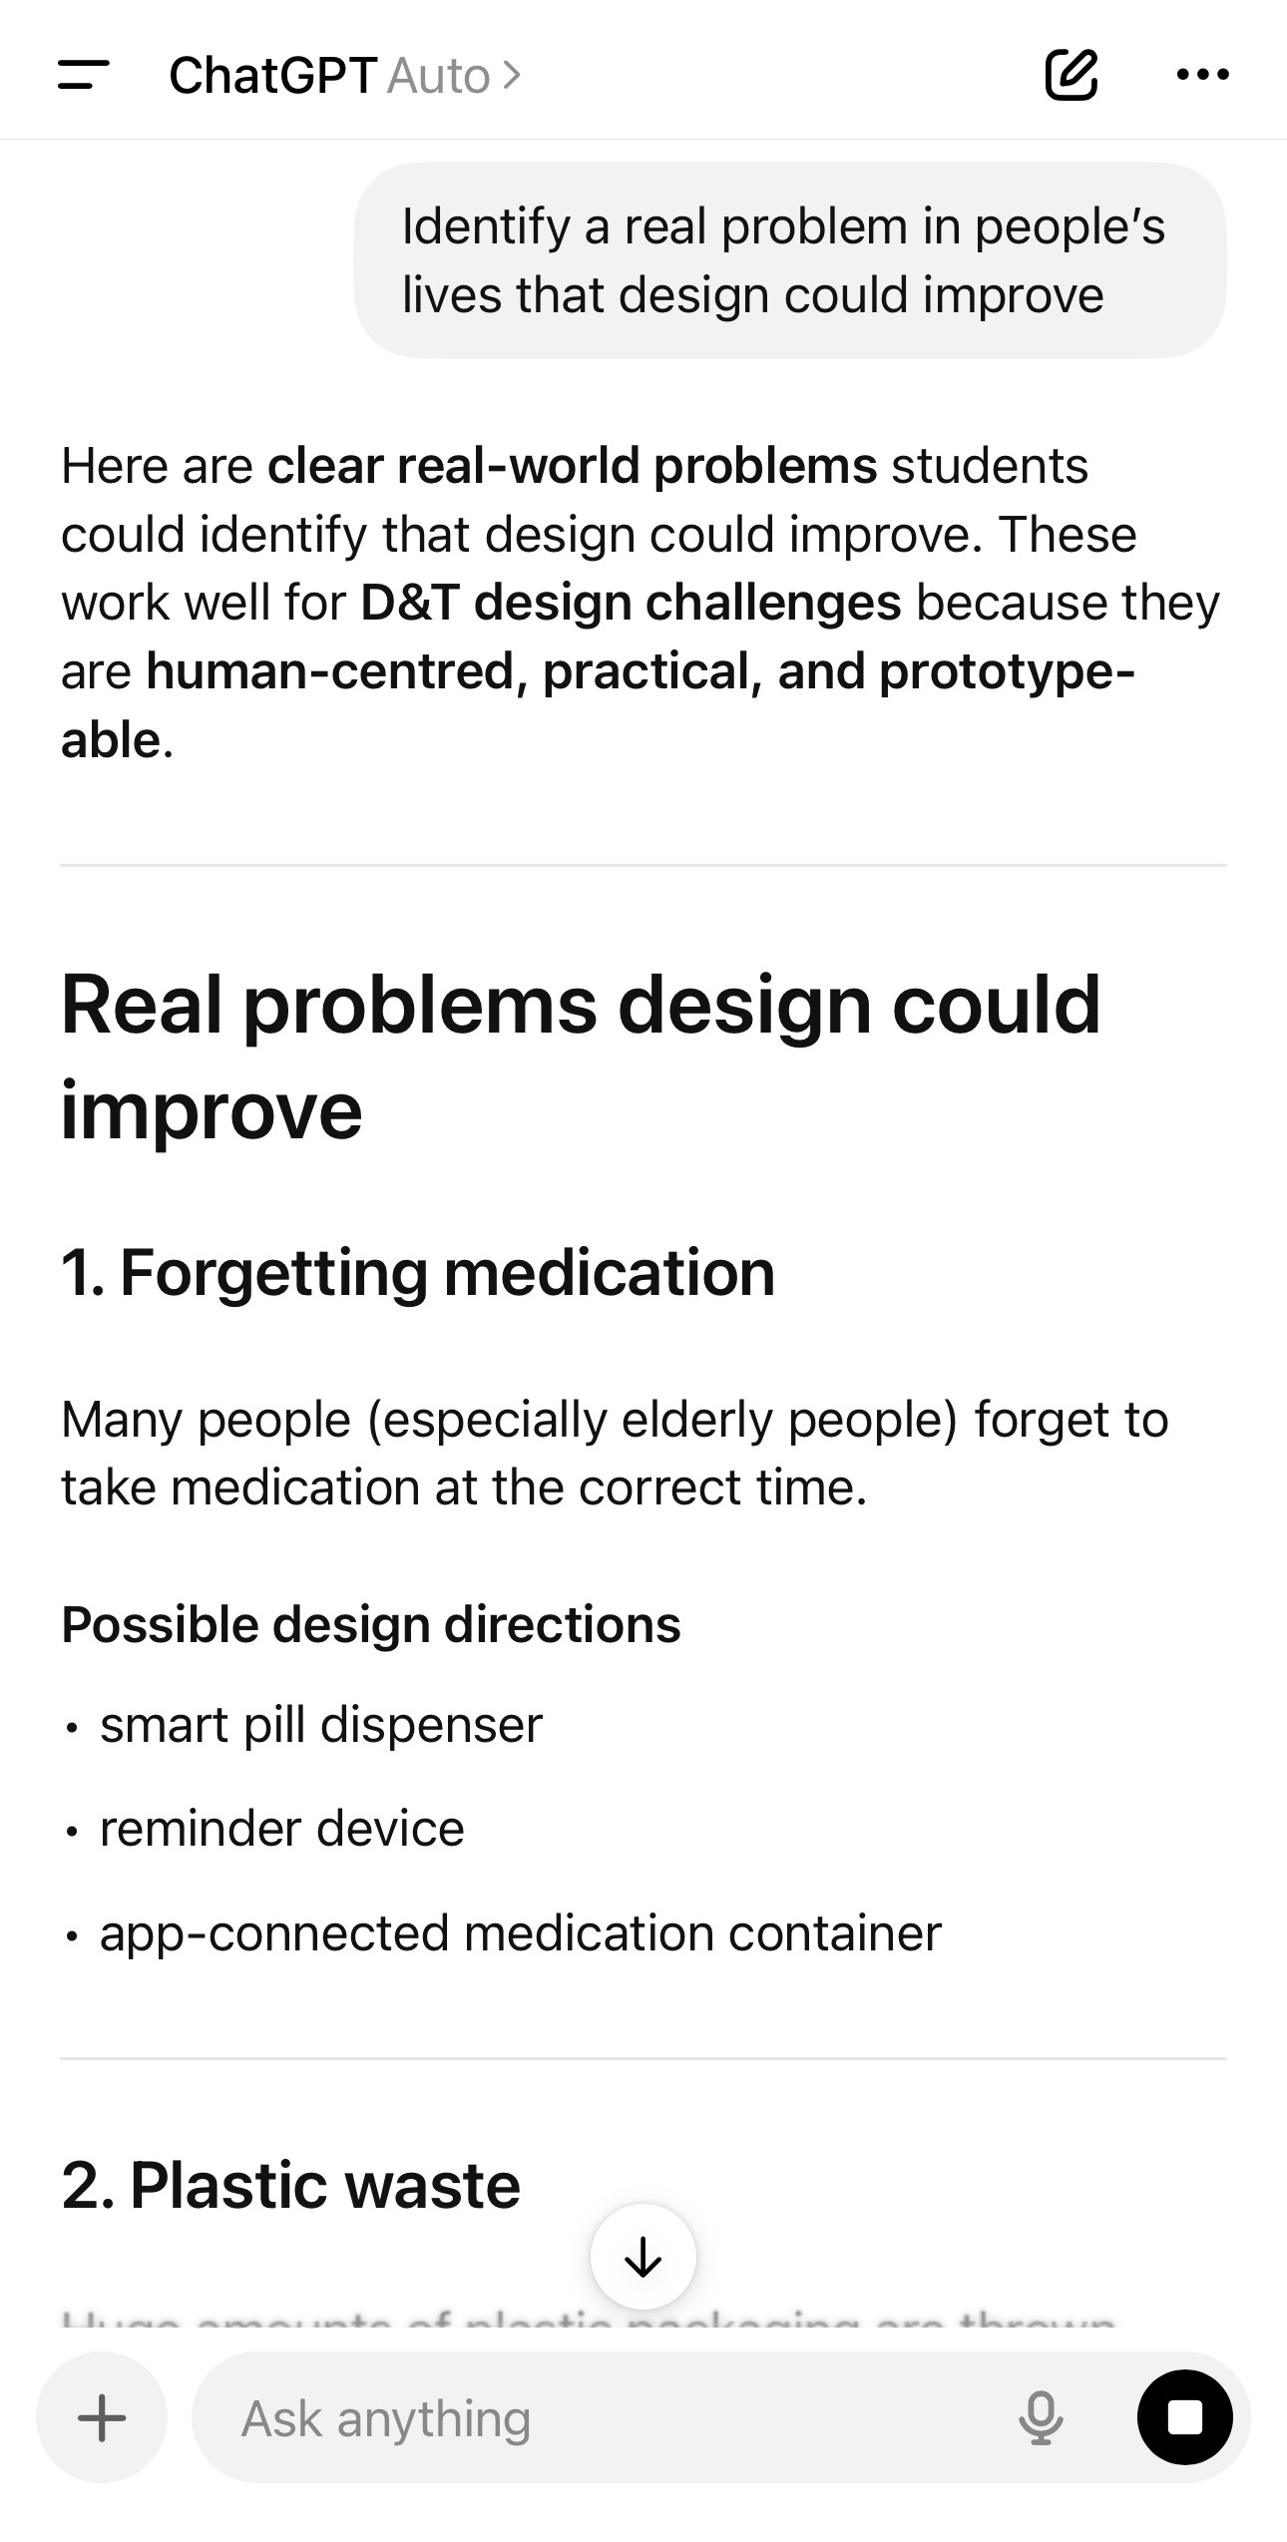

Slide 8
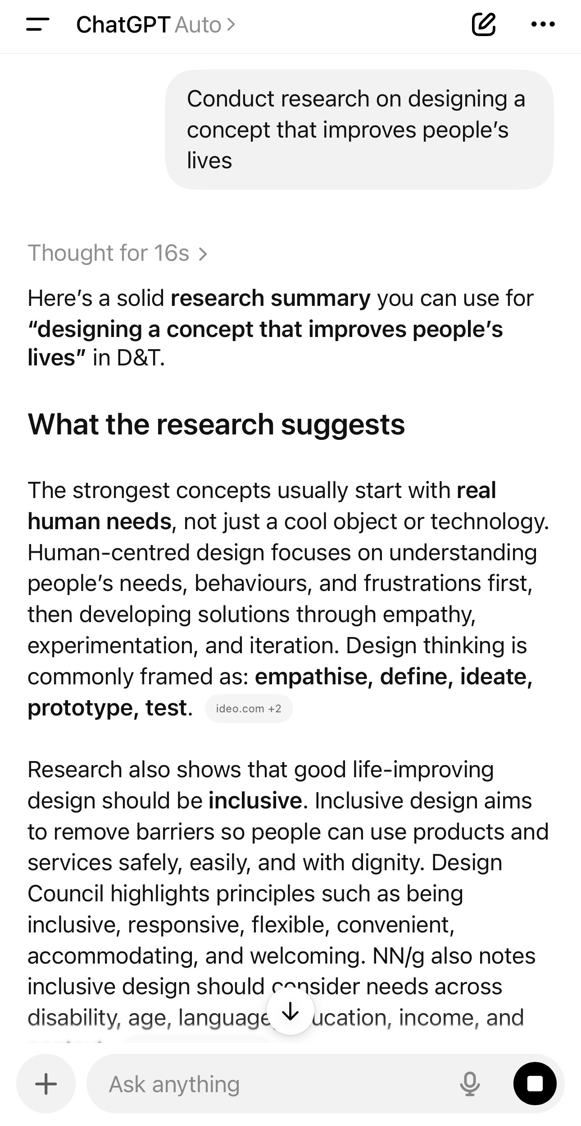

Slide 9
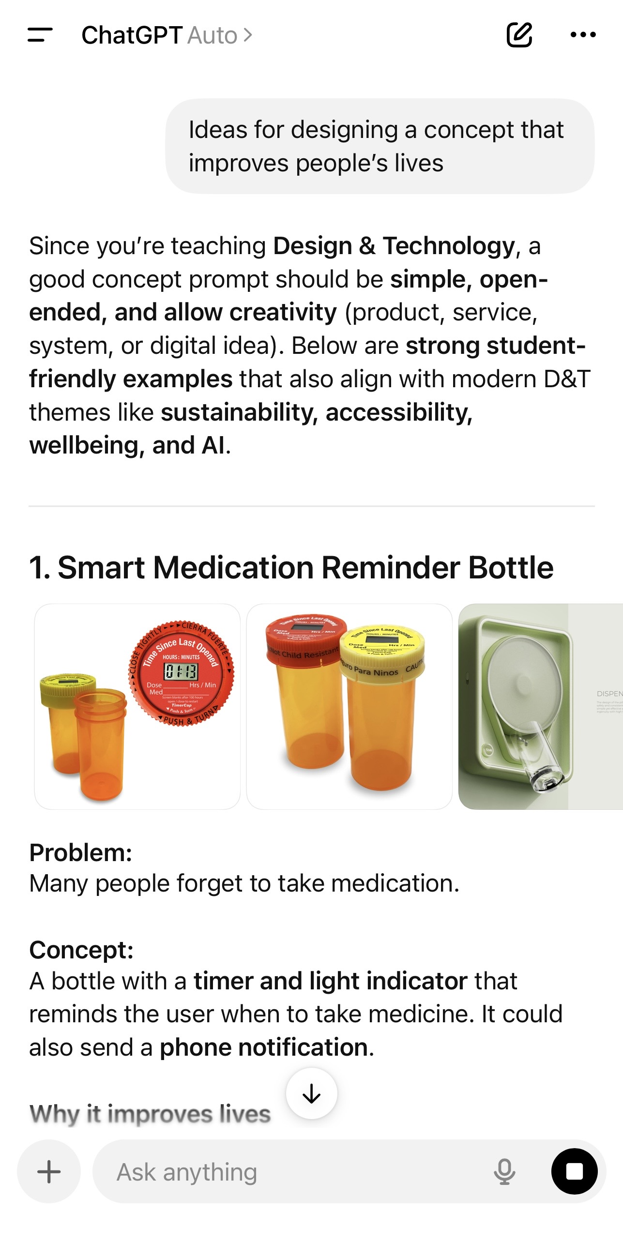

Slide 10
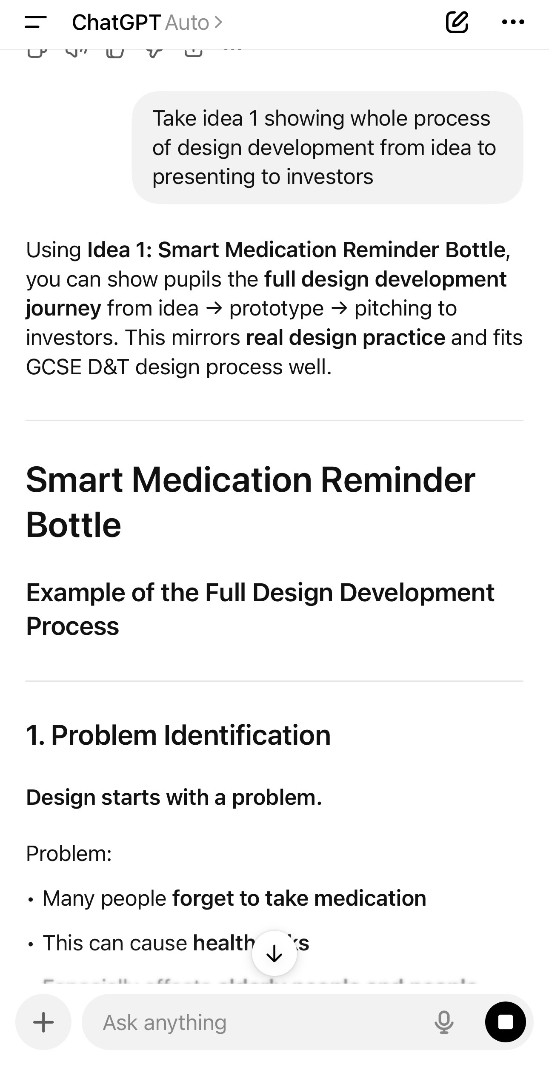

Slide 11
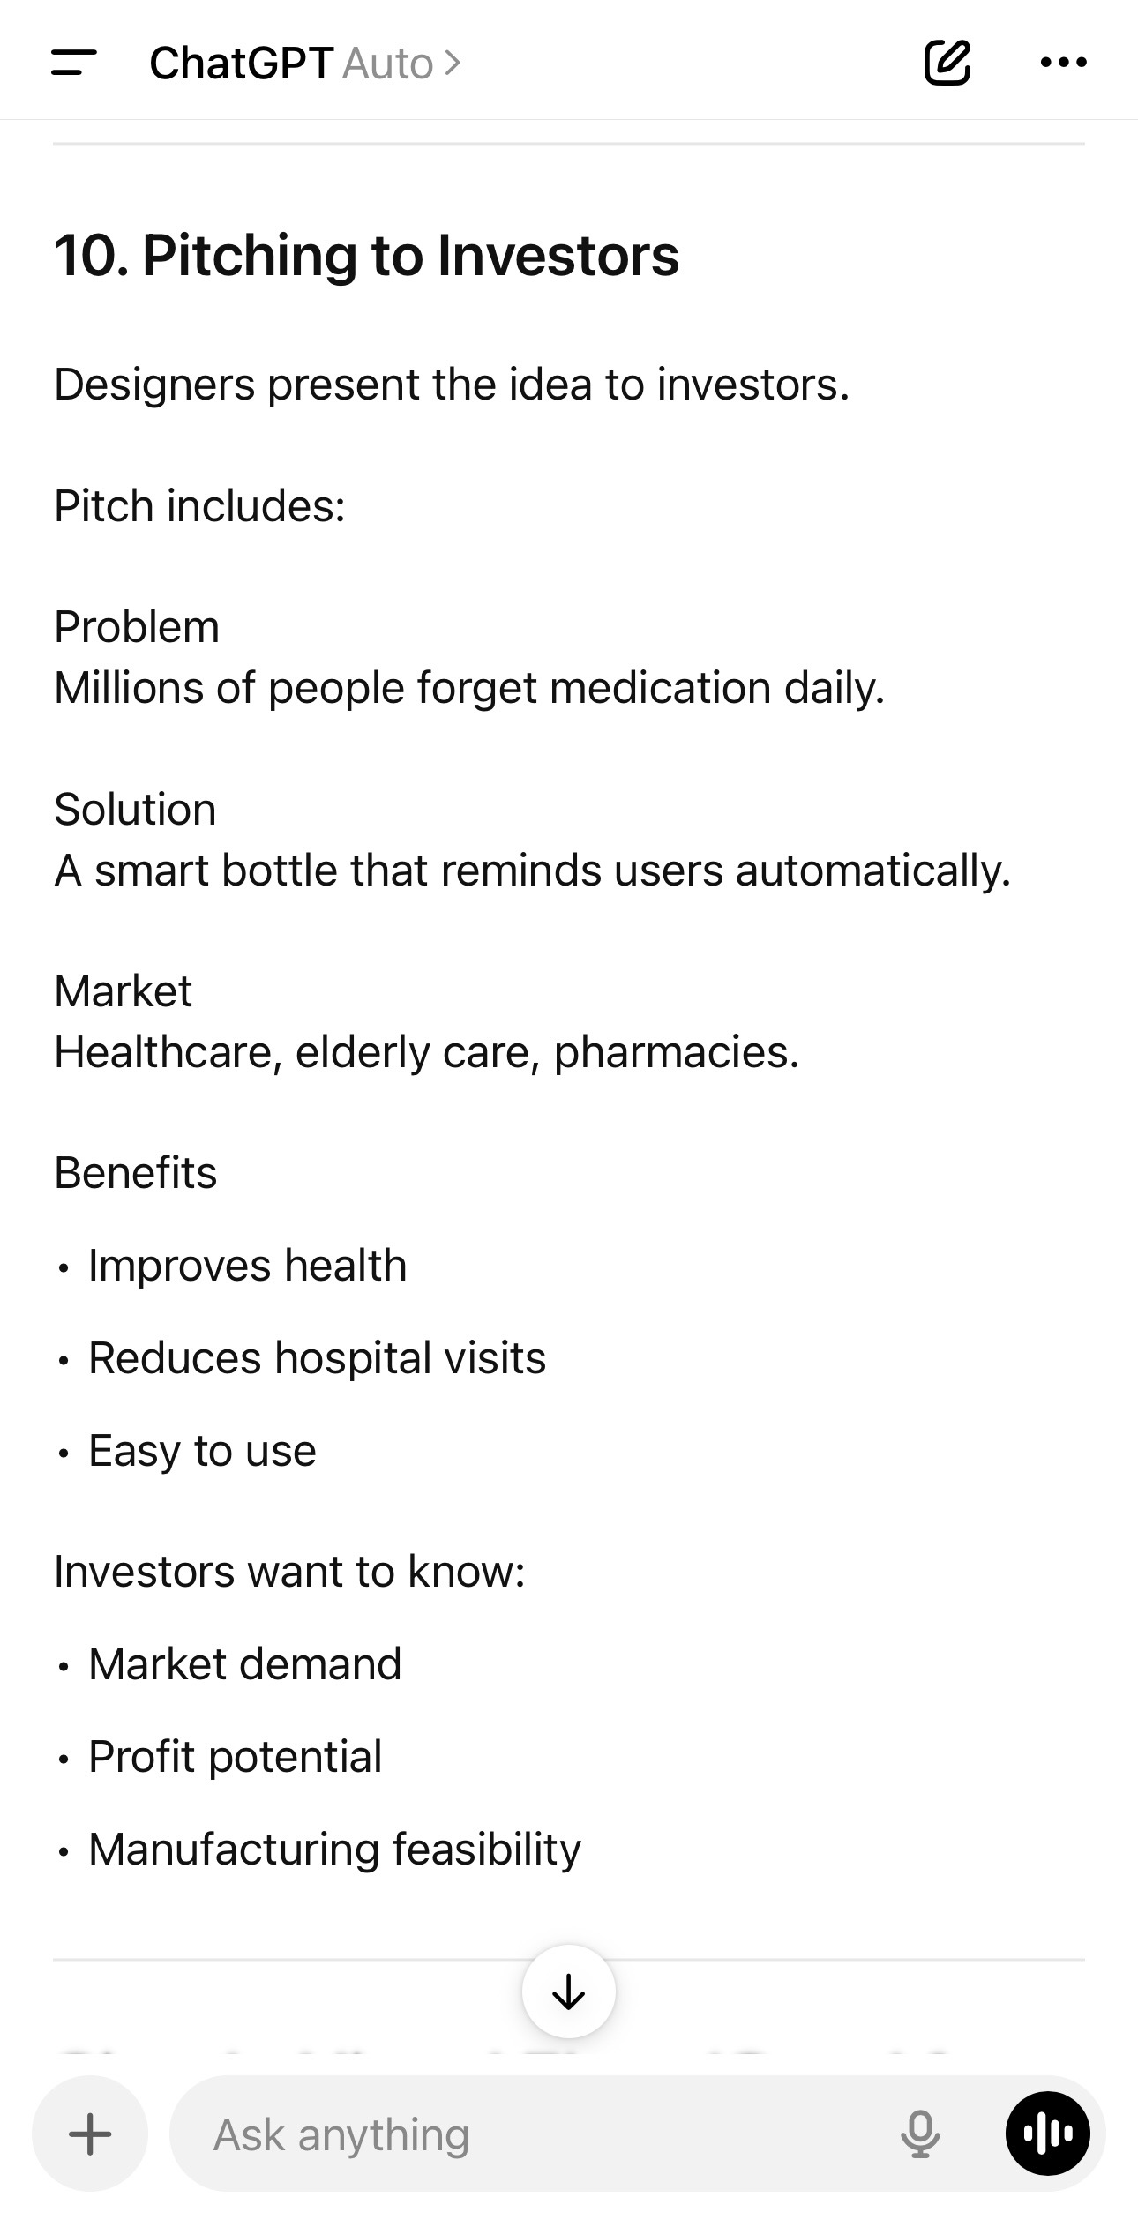

Slide 12
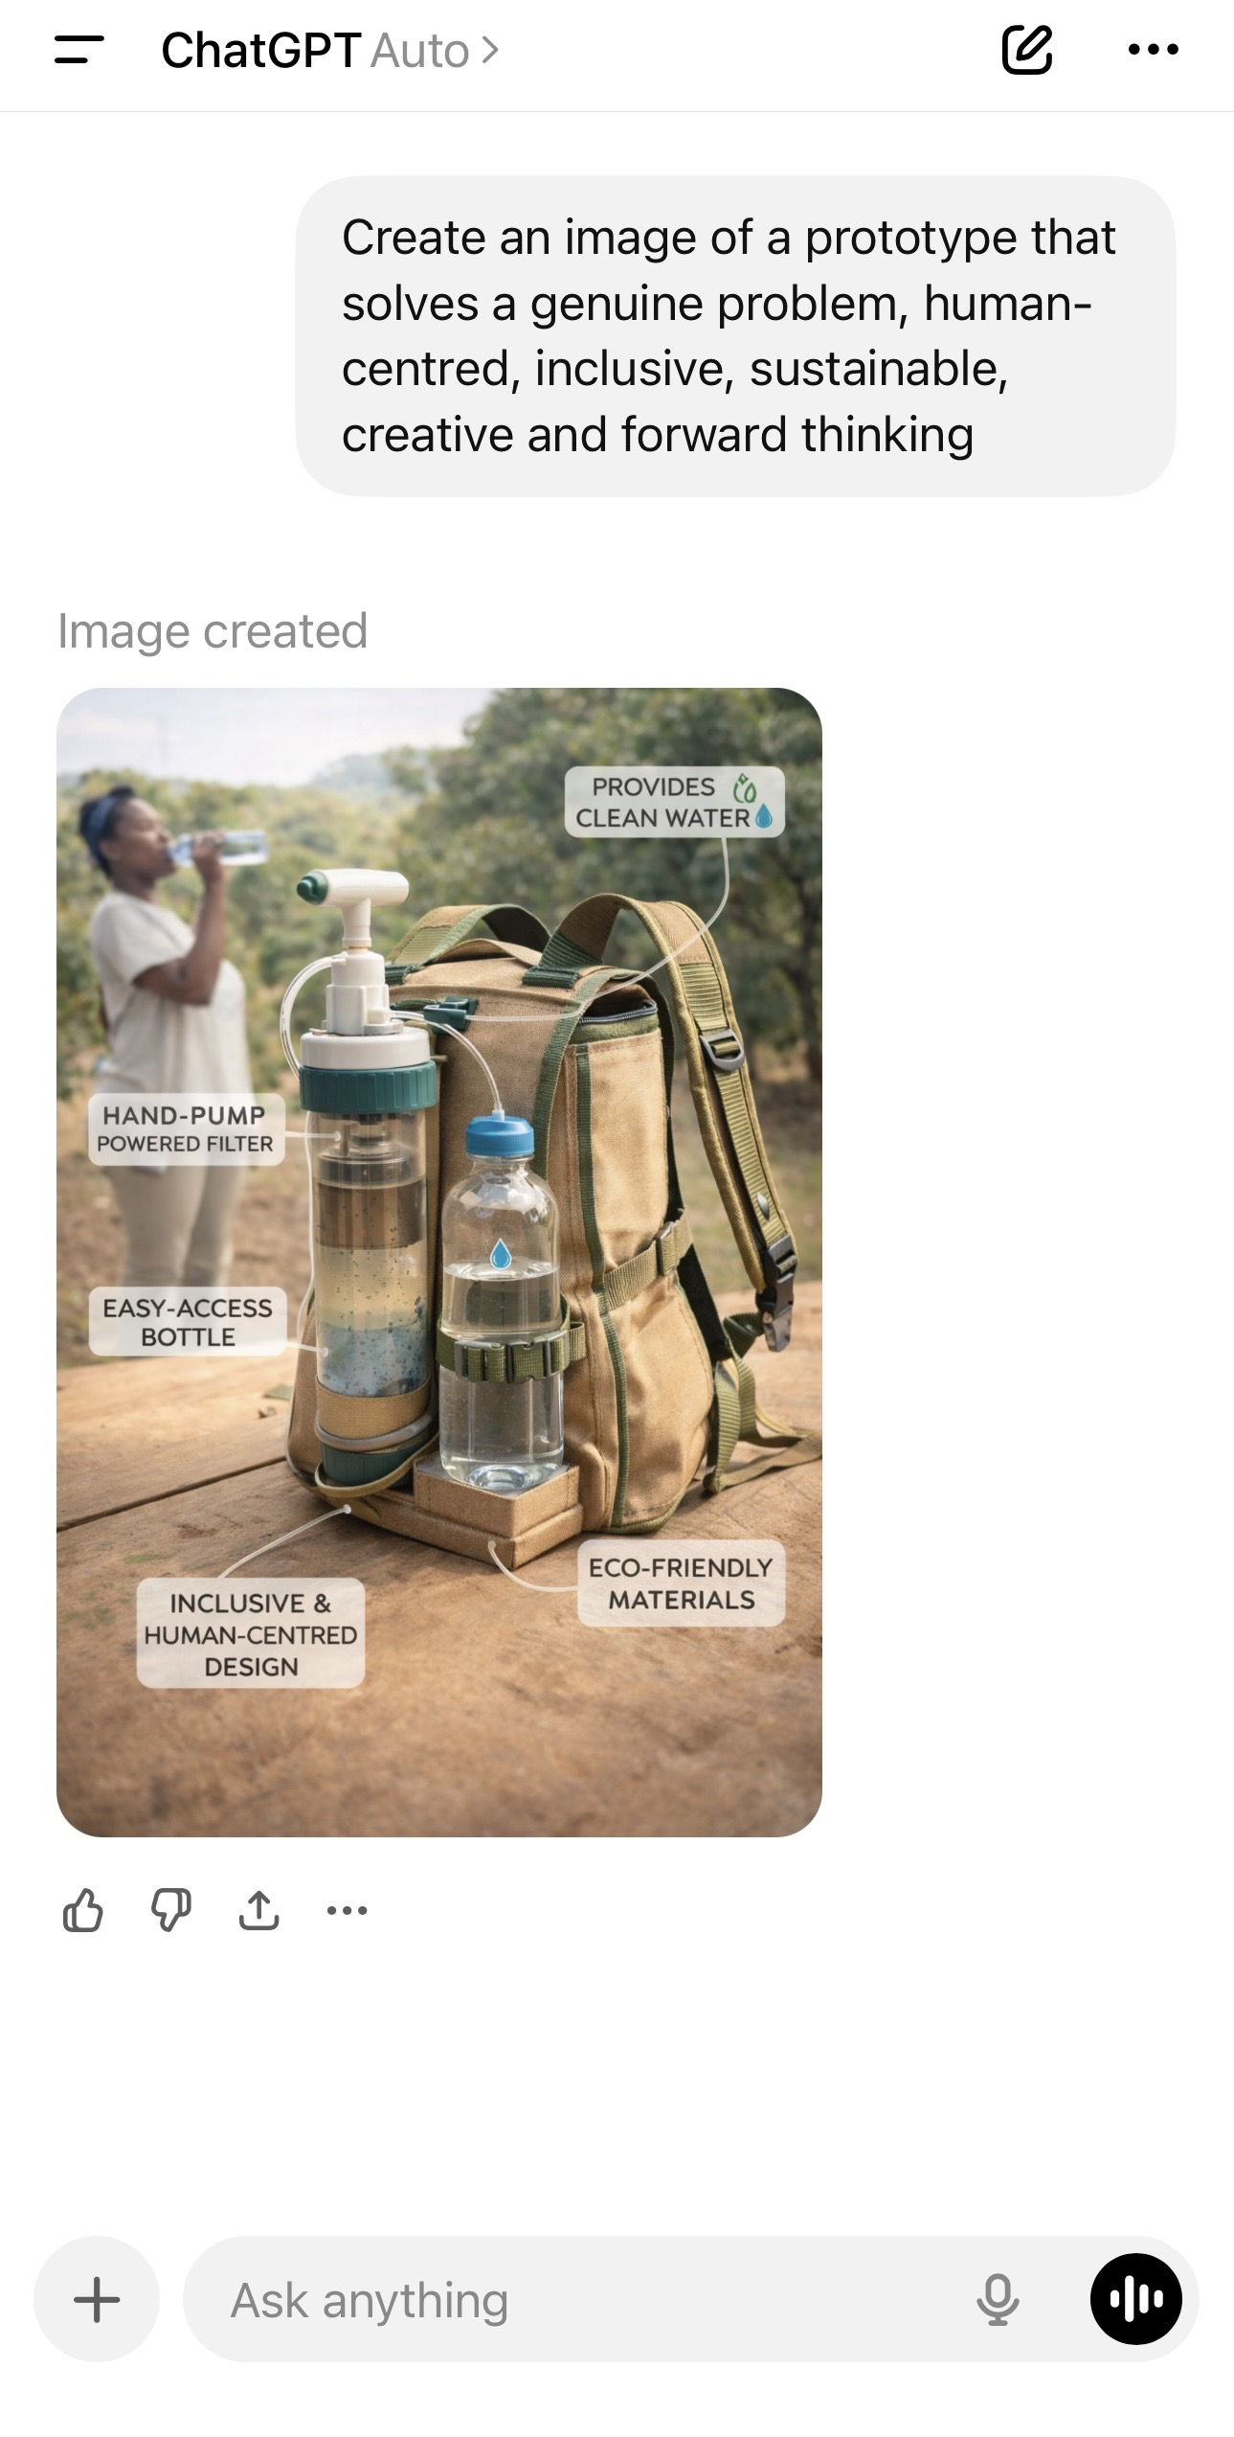

Slide 13
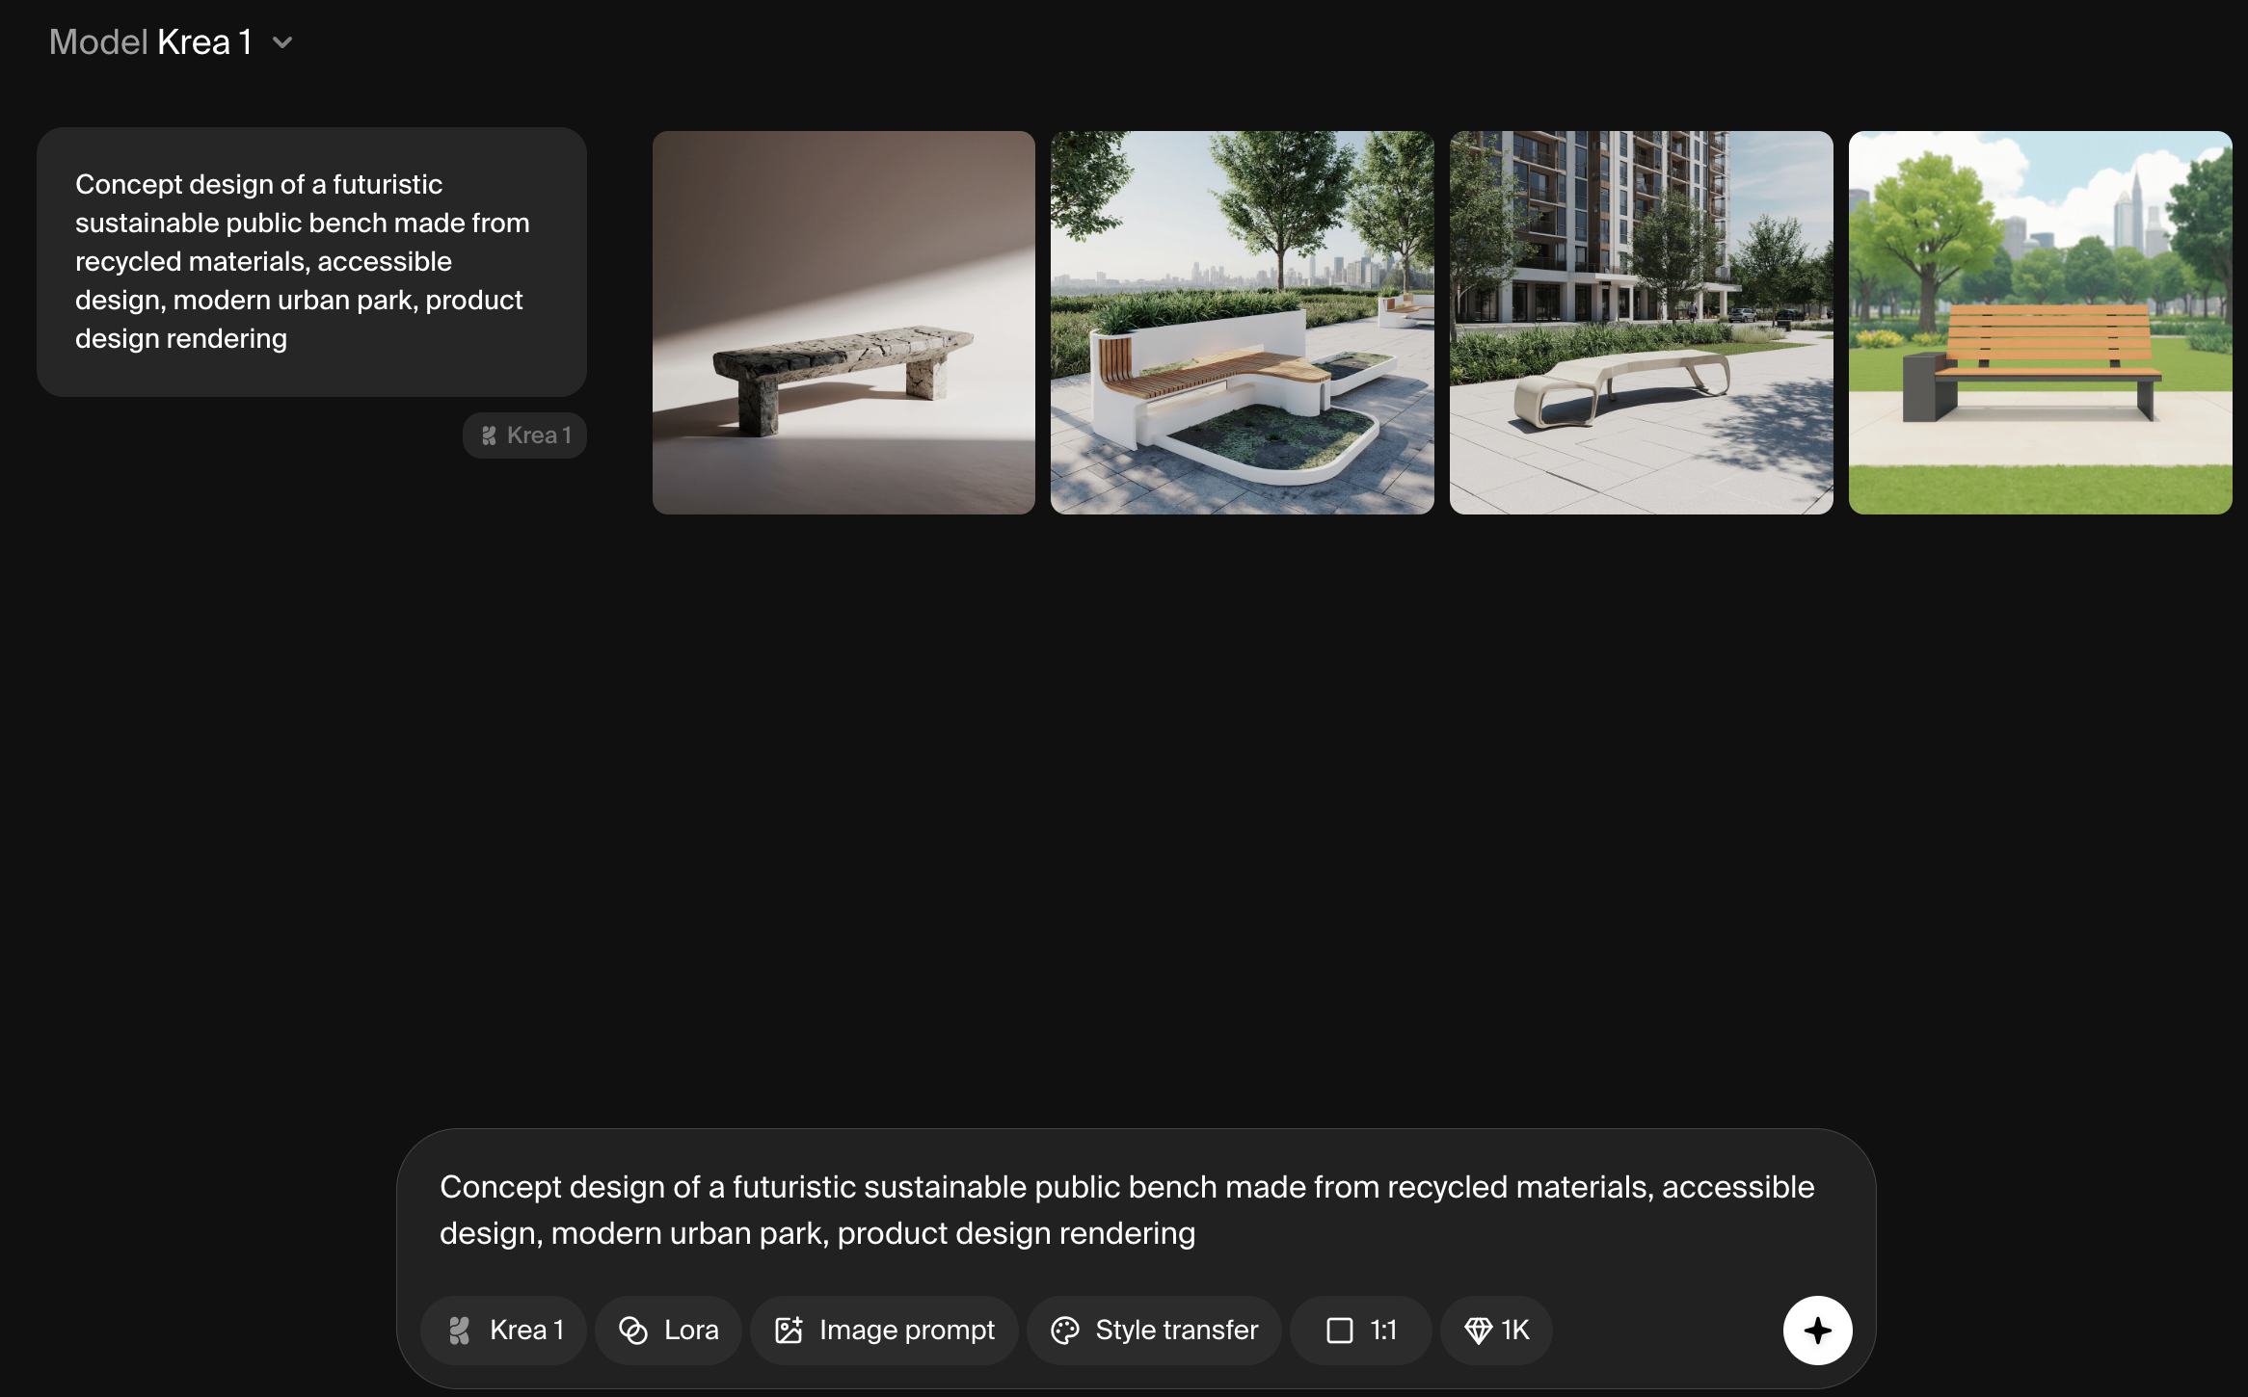
Krea: Design Iteration

Slide 14
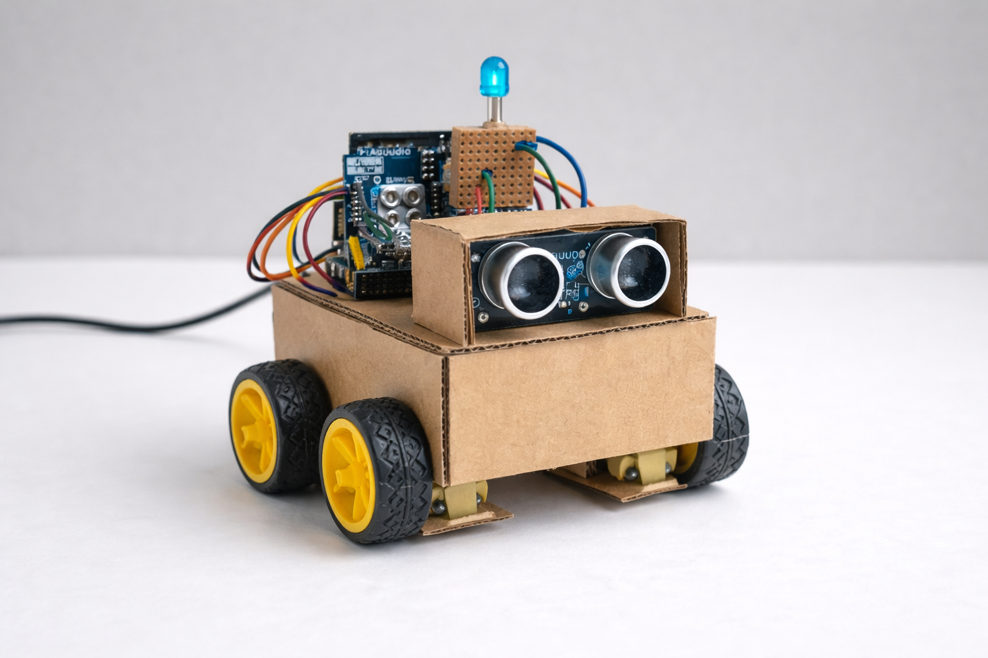
Example prototype

Slide 15
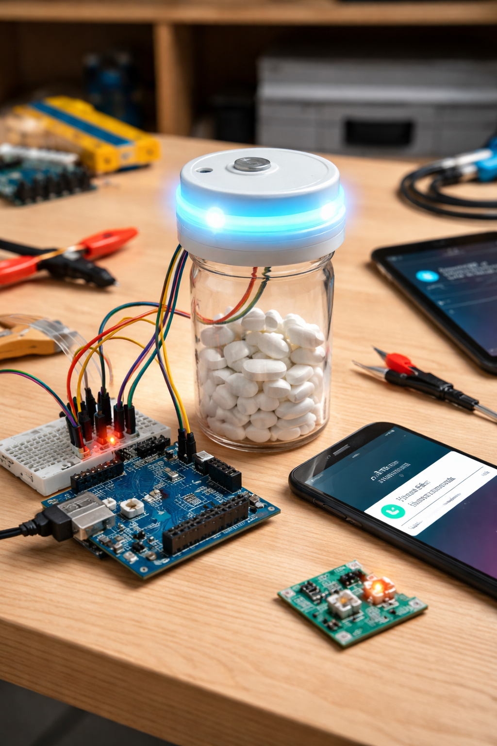
Example prototype

Slide 16
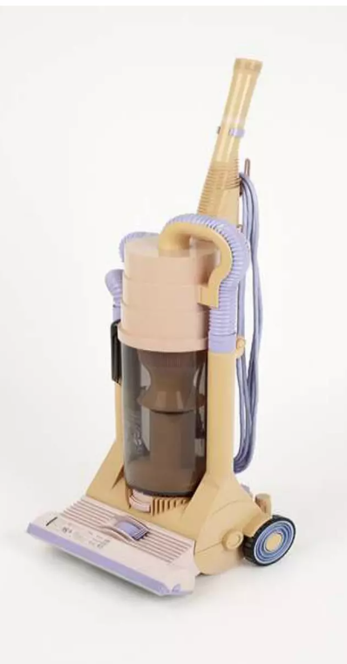
Early Dyson prototype (1993)

Slide 17
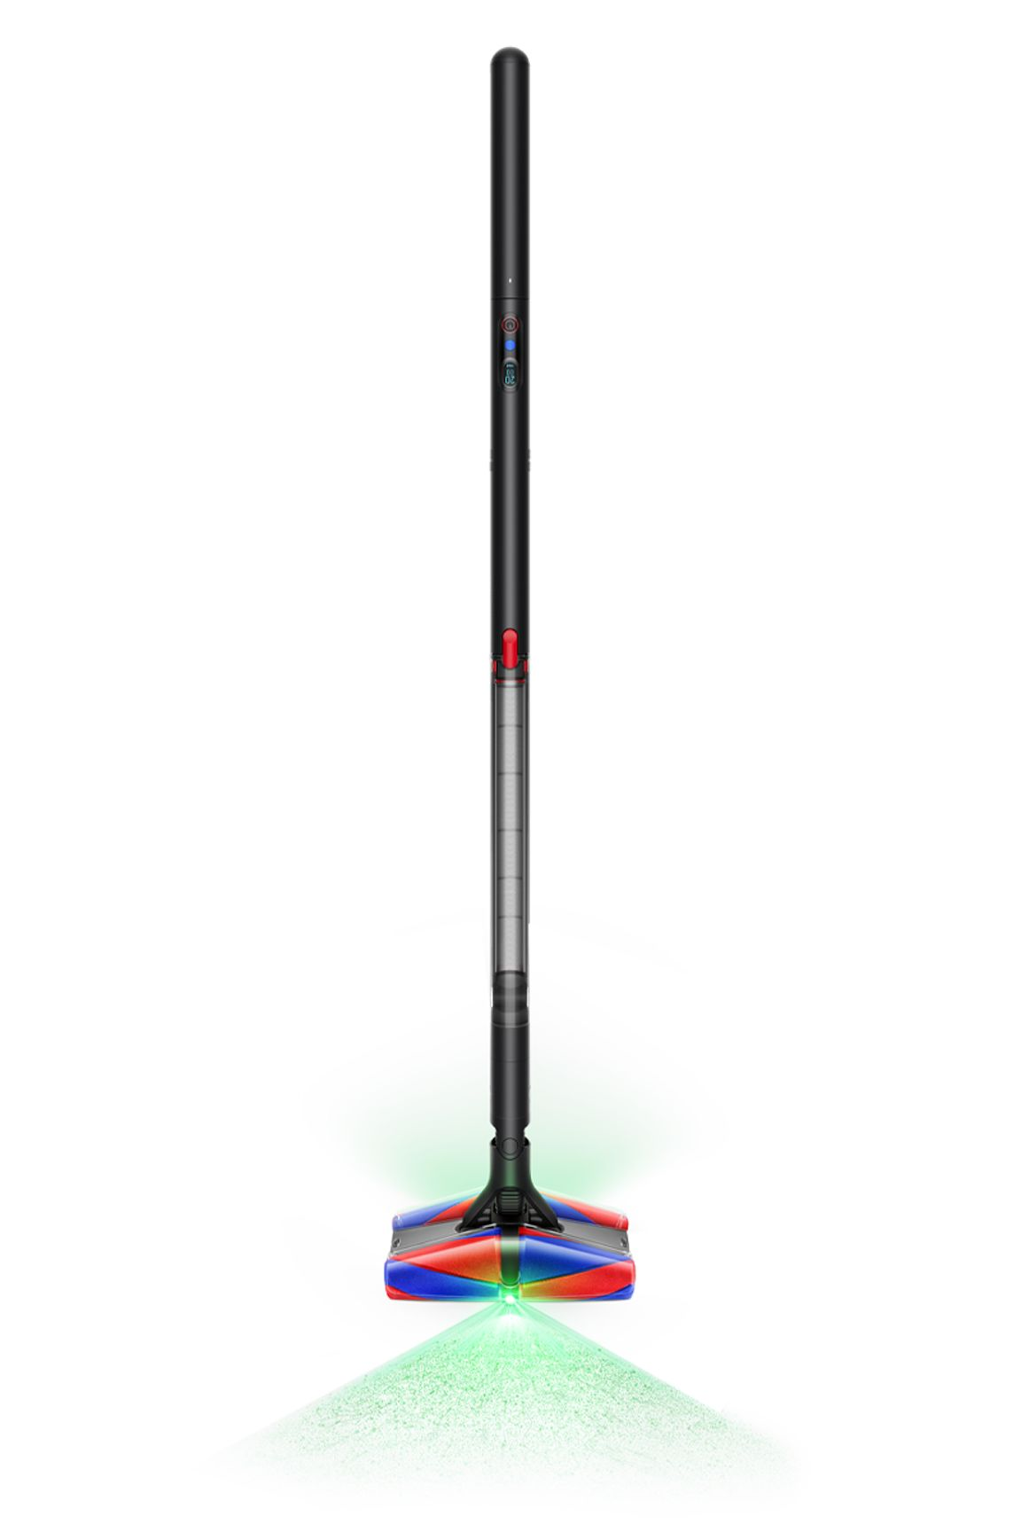
Modern Dyson Design

Slide 18
Dyson built 5,127 prototypes before success

