Slide 1

Social Impact Design Challenge

Slide 2
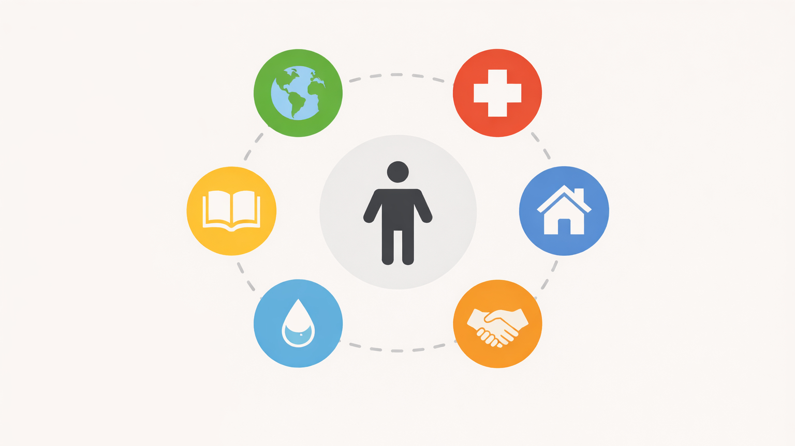

Slide 3
Design something that improves people's lives
or helps communities

Slide 4
Problem > Research > Ideas > Prototype > Test > Improve > Share

Slide 5
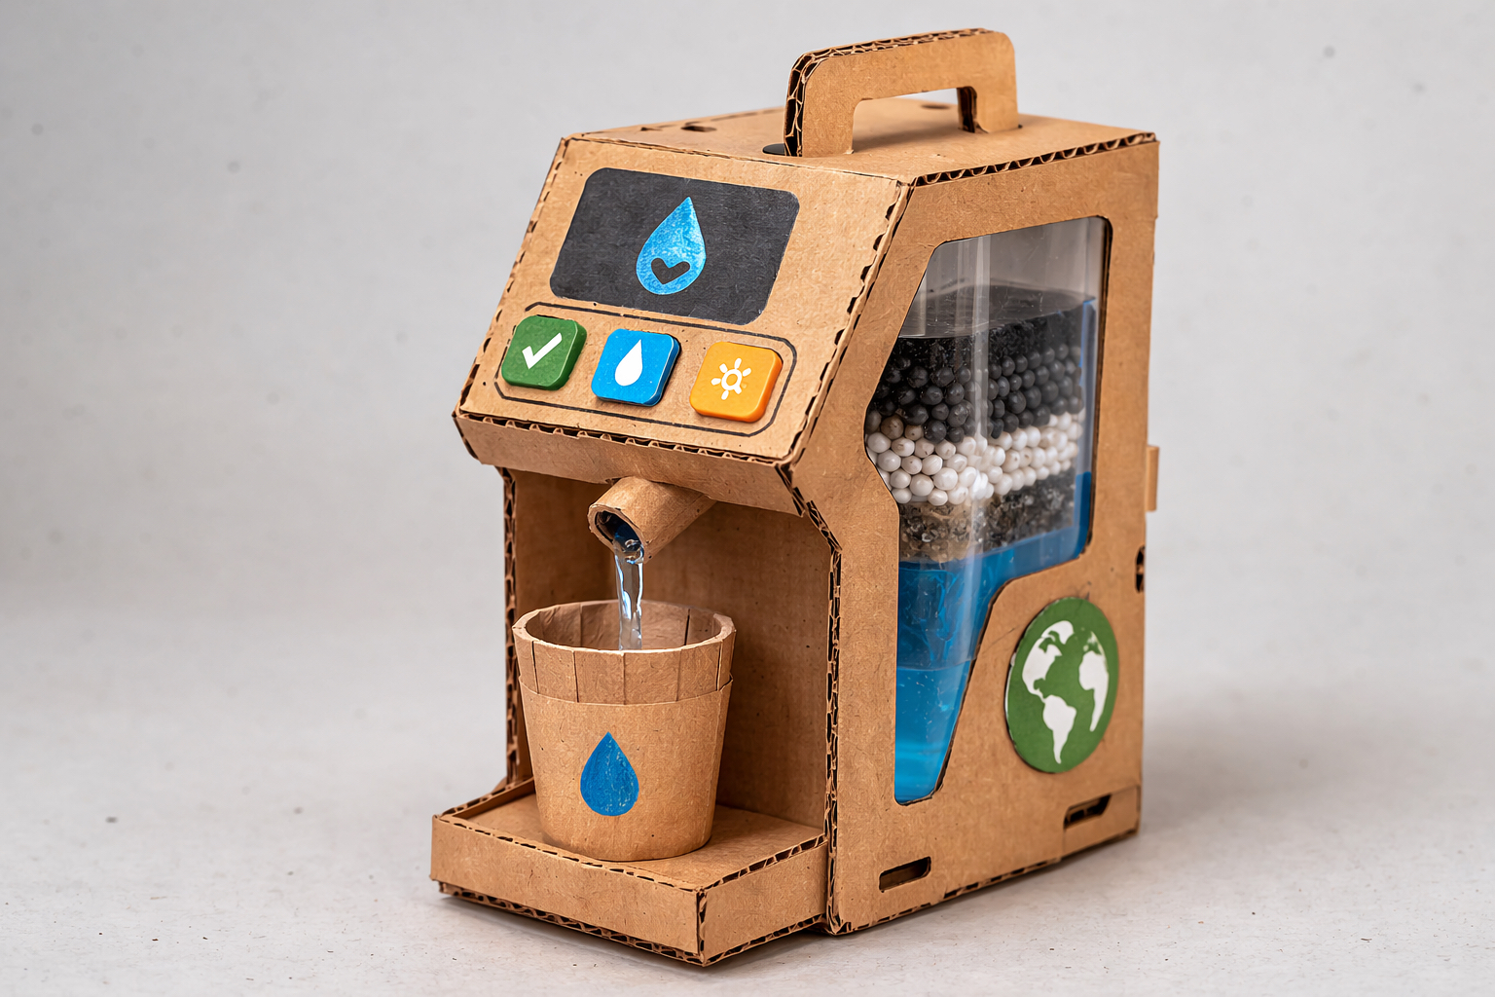
Example prototype

Slide 6
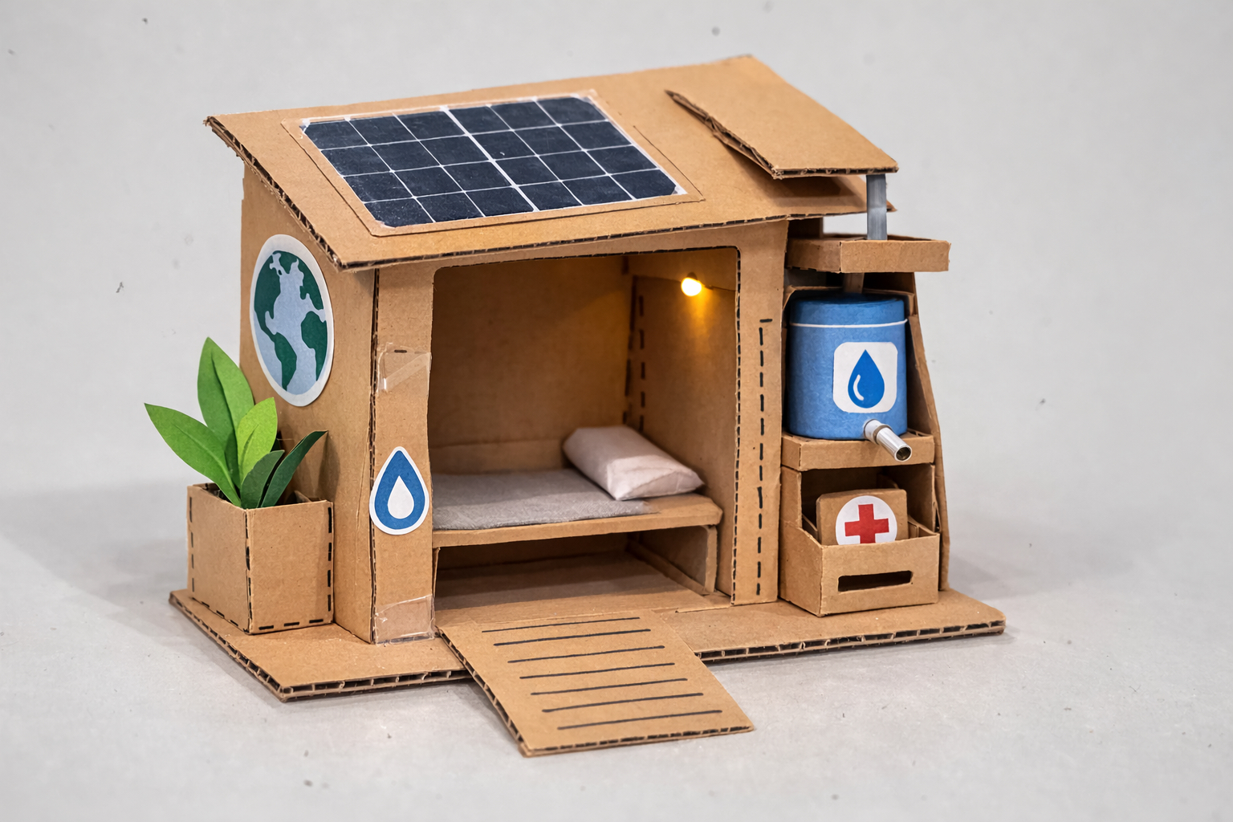
Example prototype

Slide 7
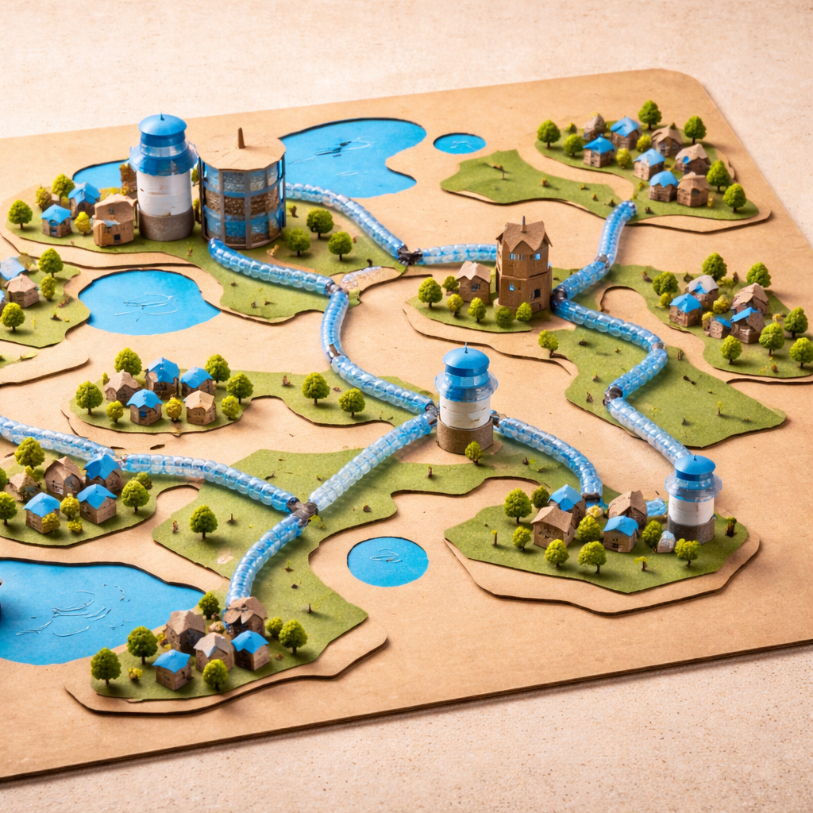
Example prototype

Slide 8
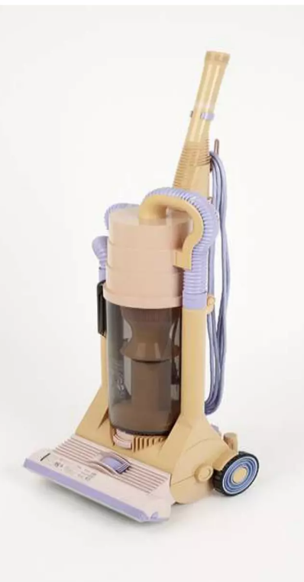
Early Dyson prototype (1993)

Slide 9
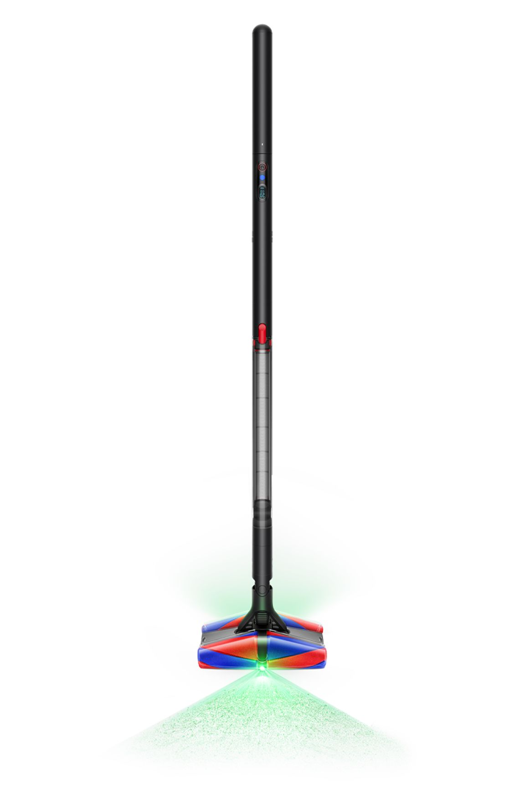
Modern Dyson Design

Slide 10
Dyson built 5,127 prototypes before success

