Slide 1

Wellbeing Design Challenge

Slide 2


Slide 3
Design something that improves
people's wellbeing or supports health and happiness

Slide 4
Problem > Research > Ideas > Prototype > Test > Improve > Share

Slide 5
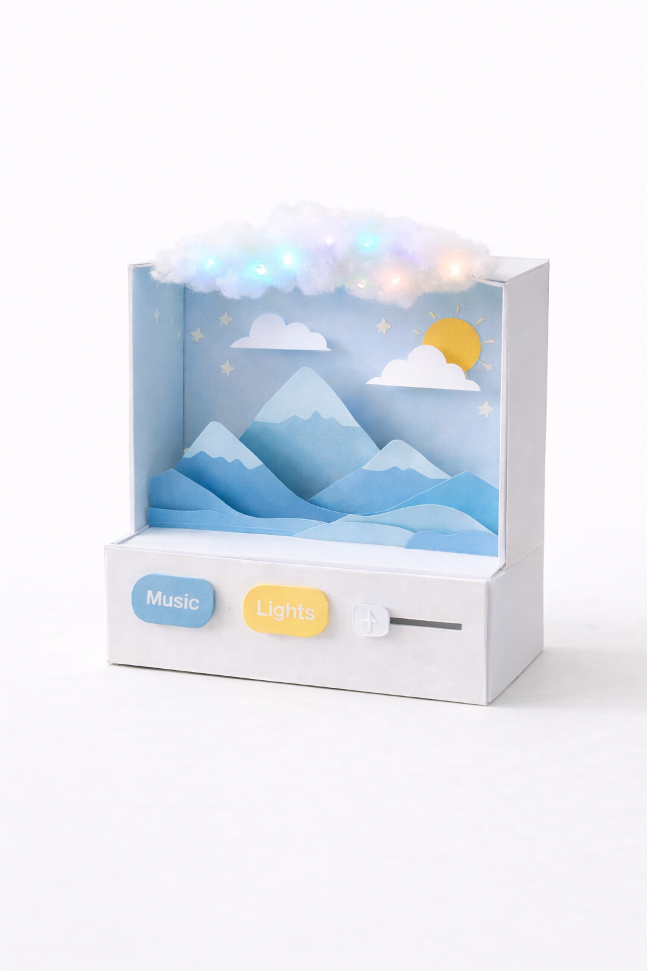
Example prototype

Slide 6
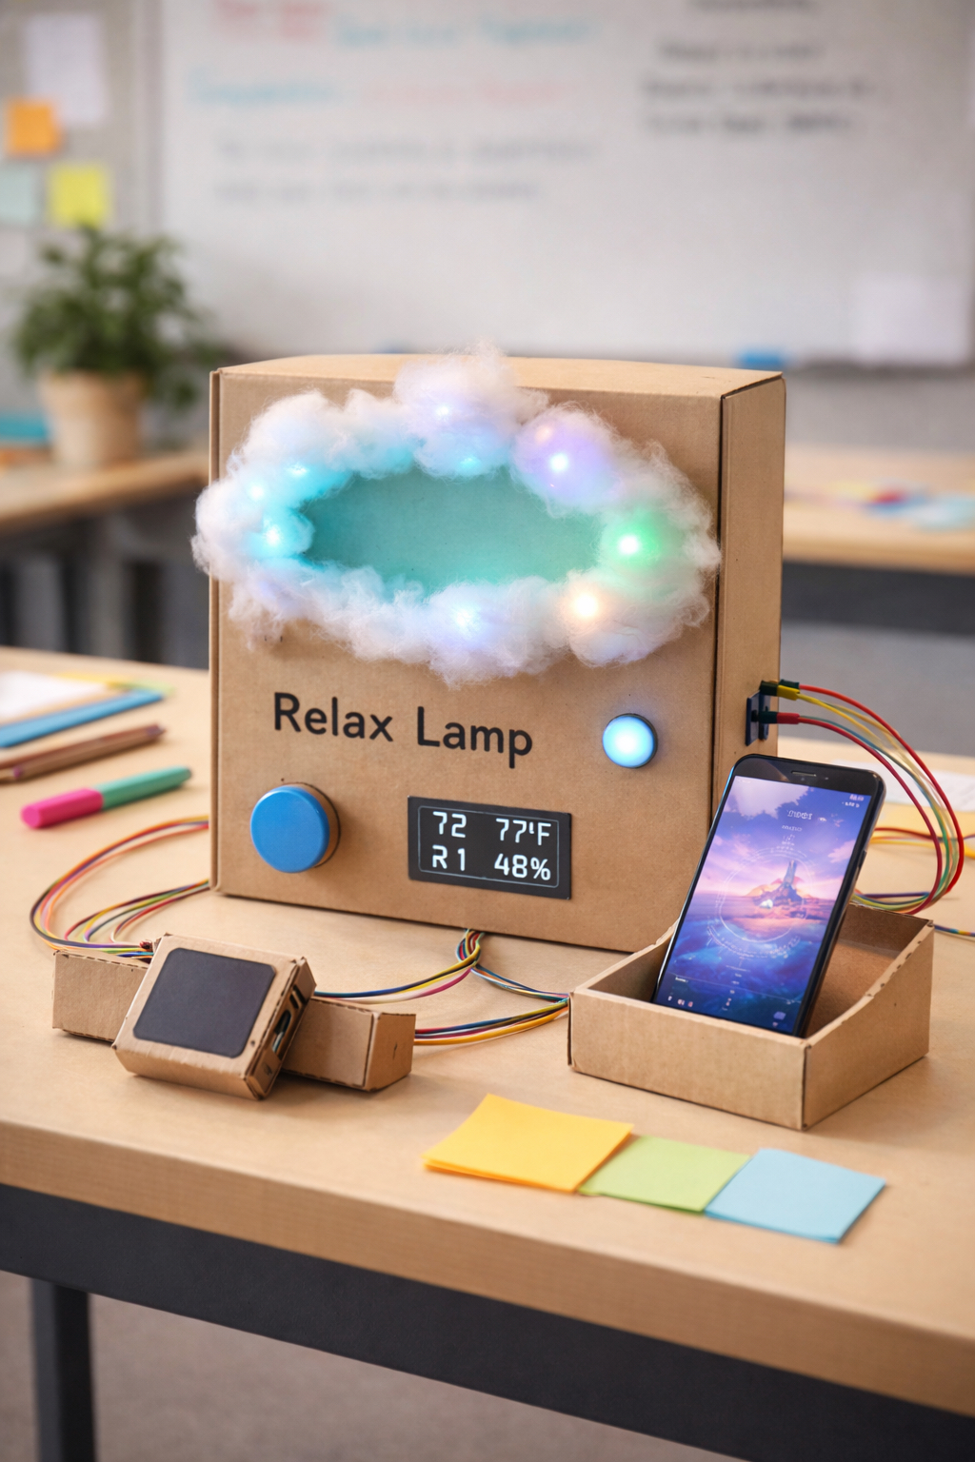
Example prototype

Slide 7
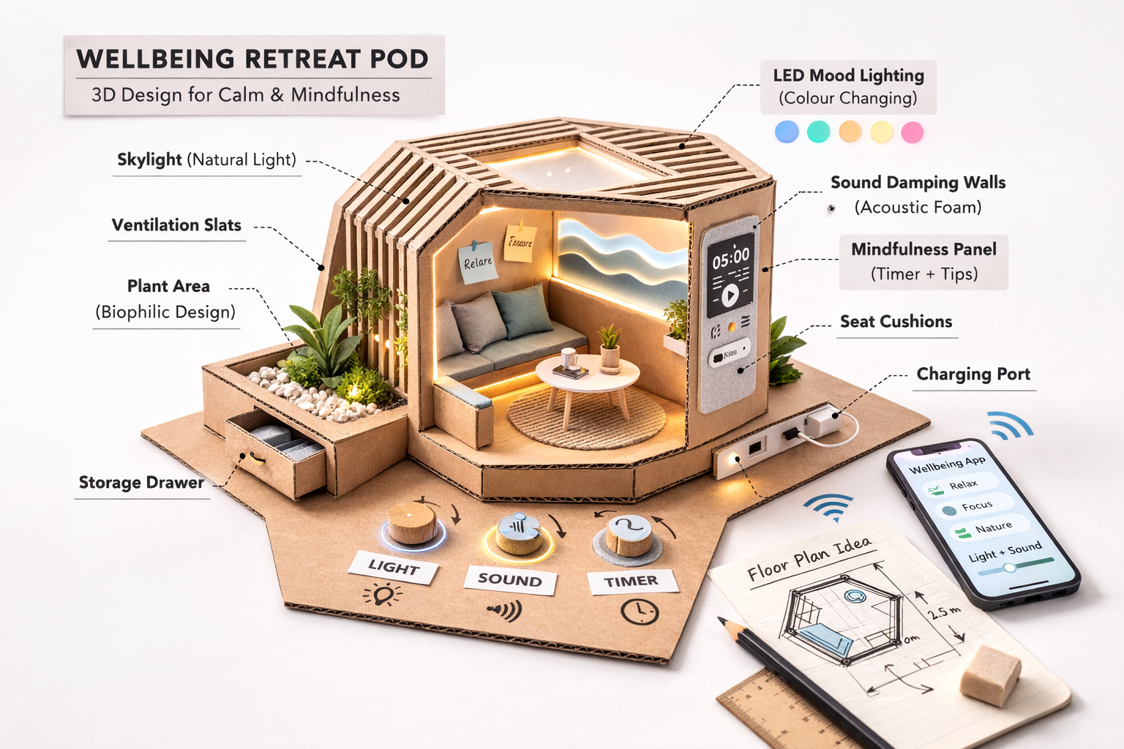
Example prototype

Slide 8
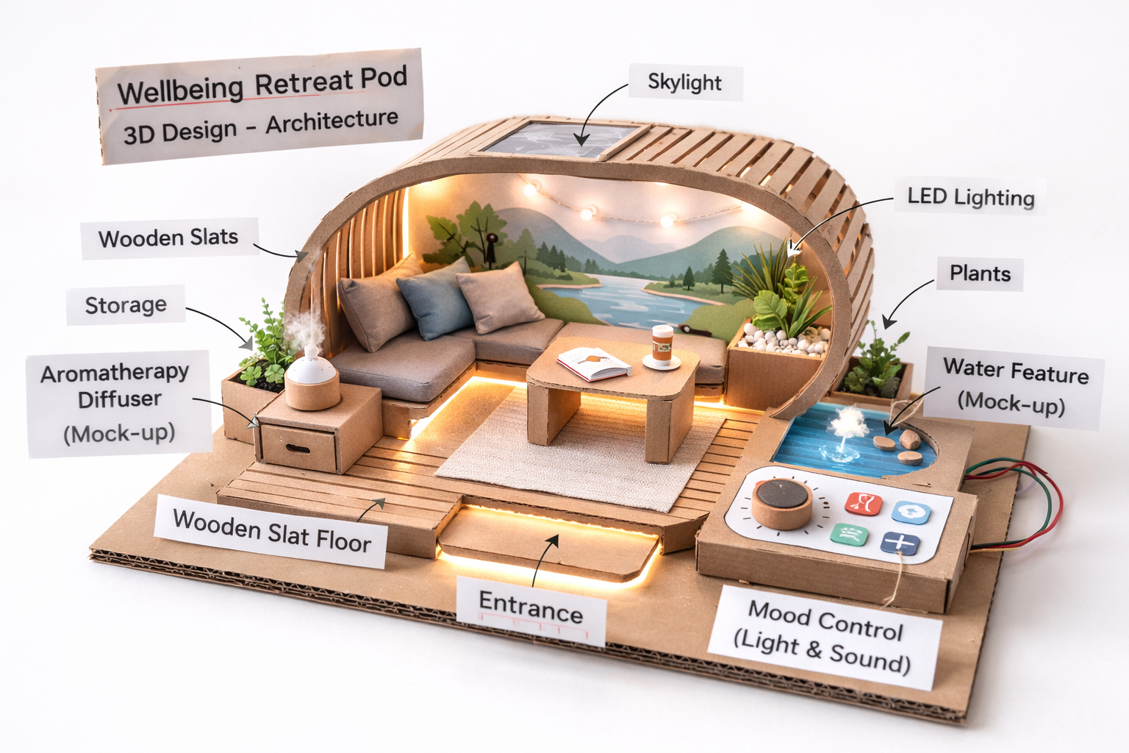
Example prototype

Slide 9
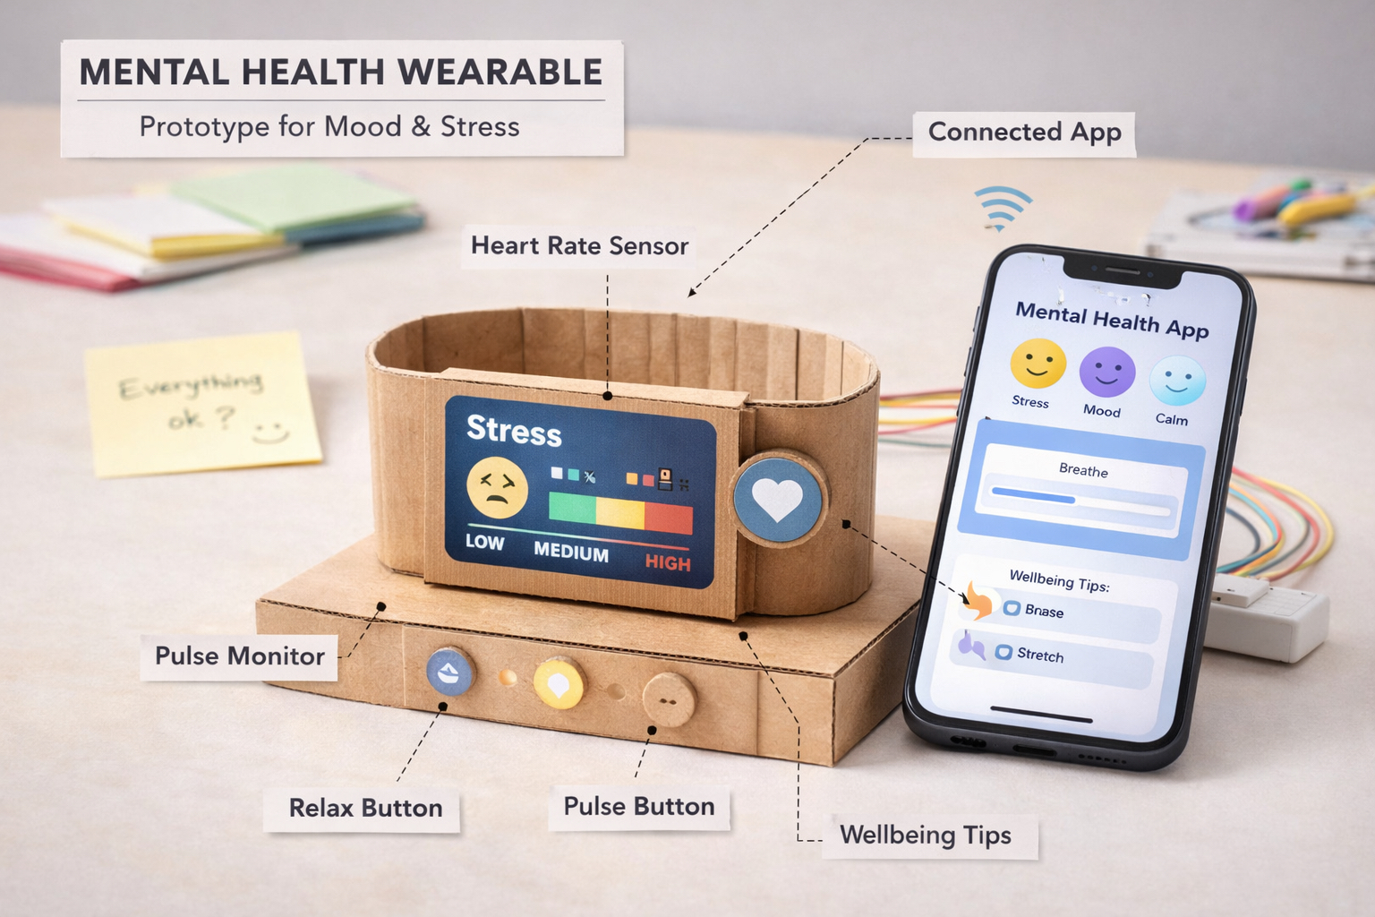
Example prototype

Slide 10
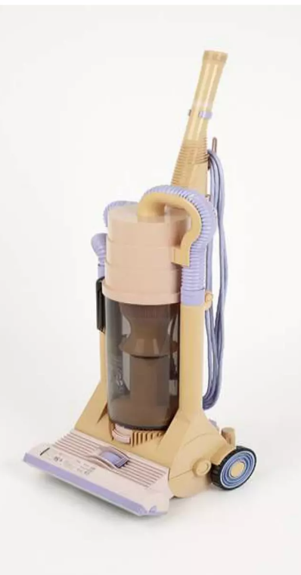
Early Dyson prototype (1993)

Slide 11
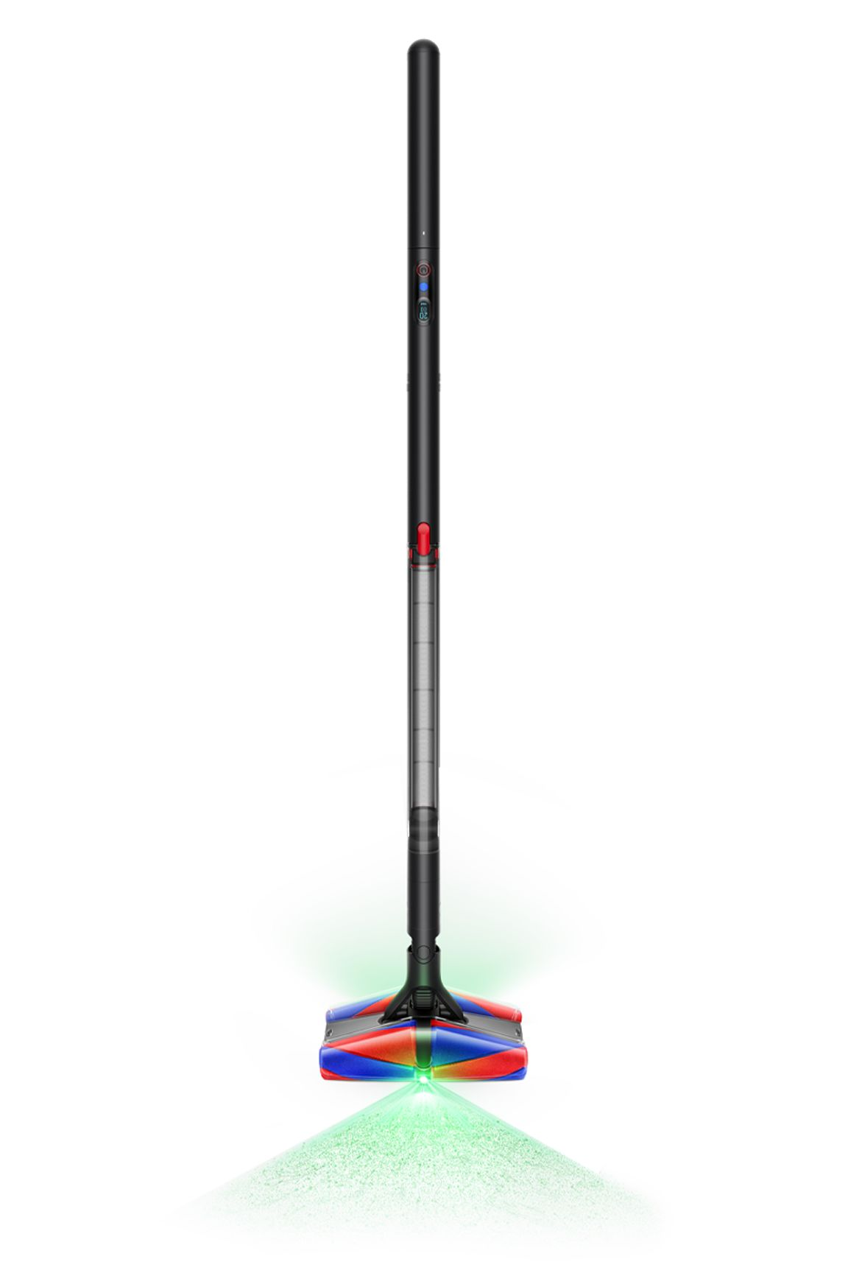
Modern Dyson Design

Slide 12
Dyson built 5,127 prototypes before success

