Slide 1
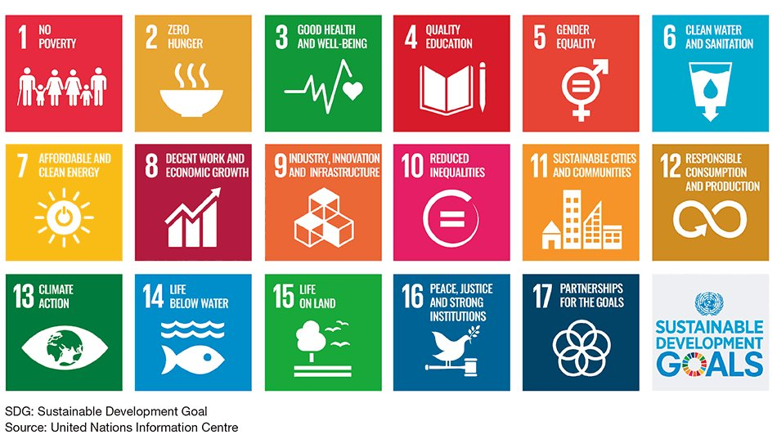

Sustainability Design Challenge

Slide 2
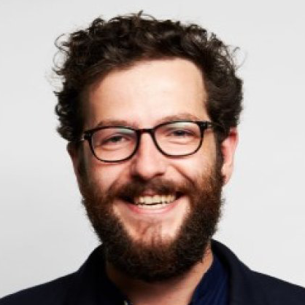
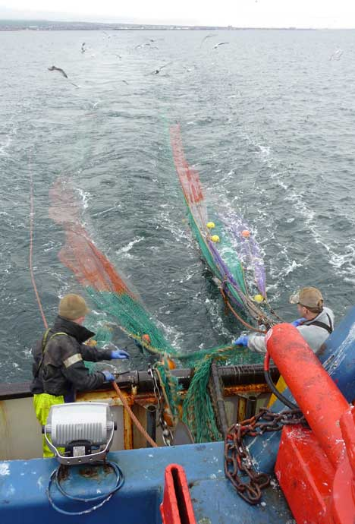
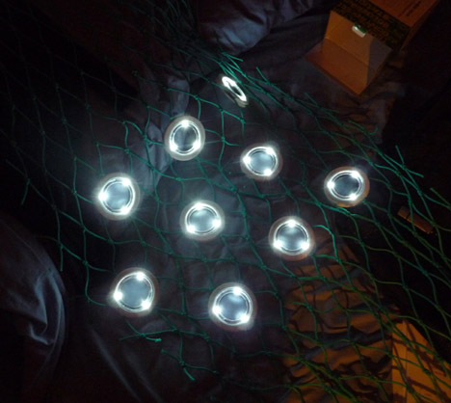
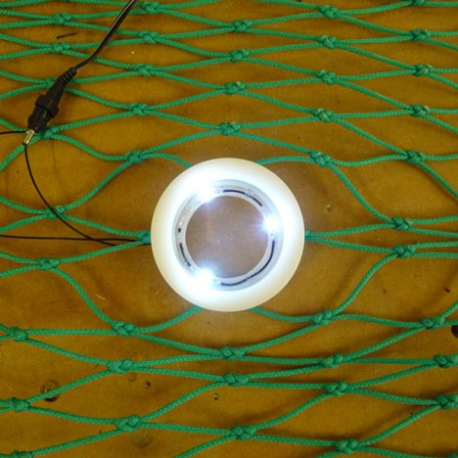
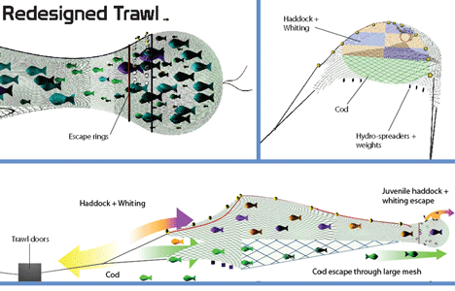
SafetyNet by Dan Watson
Royal College of Art student Dan Watson has designed a trawling net that filters young and endangered fish from the catch.
Called SatetyNet, the design uses a combination of strategically placed holes and lighting to separate fish of different ages and species.
The technique exploits behavioral and psychological differences between species of fish.
Watson created the net to tackle the huge proportion of unmarketable fish caught and thrown back into the sea dead each year.
Using the SafetyNet system, the fishing industry can become more sustainable. This will give security not only to the 40% of the world's population who rely on fish as their primary food source, but also to the fishermen within the industry itself.
Notes:
https://www.dezeen.com/2011/06/16/safetynet-by-dan-watson/
Problem > Idea > Product > Impact

Slide 3

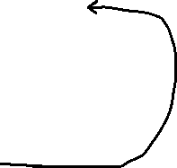

How Designers Develop Ideas
Identify a Problem
↓
Generate Ideas
(Idea 1 – Idea 2 – Idea 3 – Idea 4)
↓
Select Promising Ideas
↓
Create Prototypes
(Prototype 1 – Prototype 2 – Prototype 3)
↓
Test Ideas
(User Feedback)
↓
Improve / Modify Design
↓
Refined Prototype
↓
Final Design
↓
Generate New Ideas

Slide 4
10-minute Quick design warm-up challenge
Think like a designer.
Identify a real-world problem that design could solve.
Design Challenge
Choose a real-world problem and sketch ideas for a product, system, or service that could improve it.
2 minutes - Discuss in groups of 3
What real-world problems could design improve?
2. Write 3 problems
3. 5 minutes - Sketch as many ideas as possible that could helpsolve one problem.
4. Share

Slide 5
Design something that improves the environment
inspired by a Sustainable Development Goal

Slide 6
Problem > Research > Ideas > Prototype > Test > Improve > Share

Slide 7
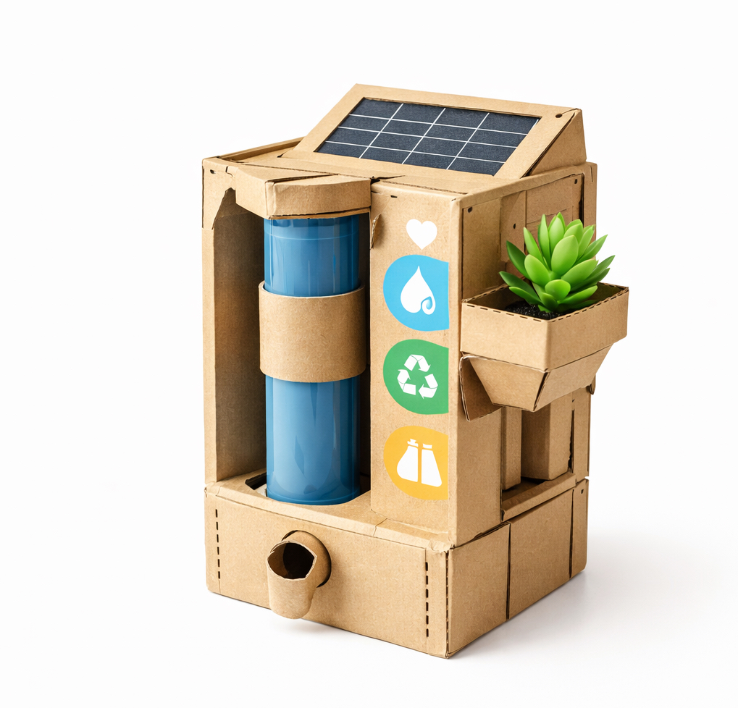
Example prototype

Slide 8

“I’m convinced that about half of what separates successful entrepreneurs from the non-successful ones is pure perseverance.”
“Sometimes when you innovate, you make mistakes. It is best to admit them quickly and get on with improving your other innovations.”
Steve Jobs
Was an American entrepreneur, industrial designer, and co-founder of Apple Inc.

Slide 9
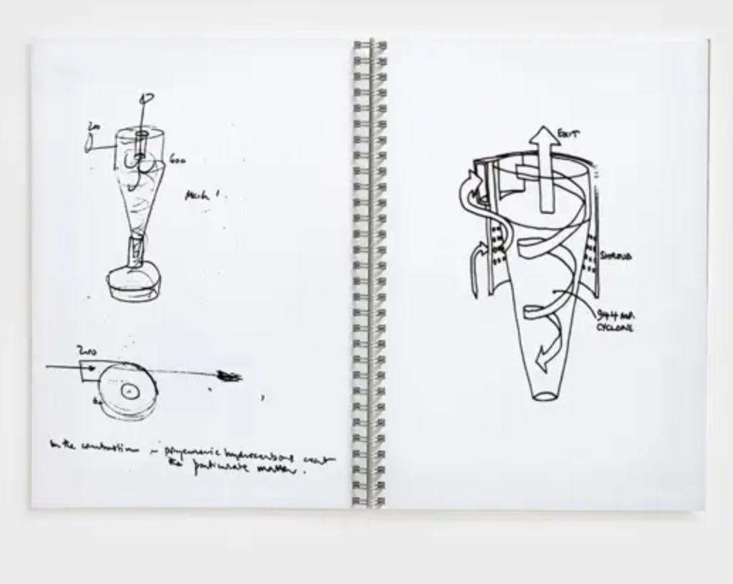
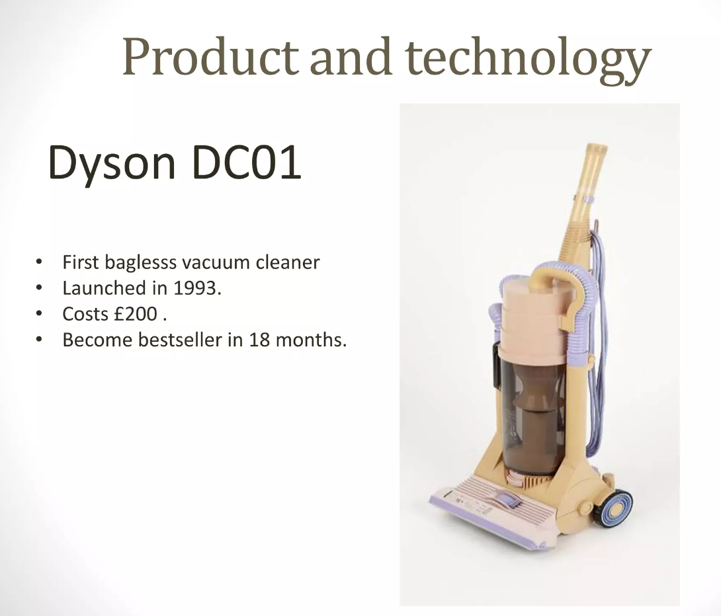

PERSEVERANCE AND PERFECTIONISM
5,127 PROTOTYPES
James knew he was onto something, but it would take time to perfect his idea. Five years and 5,127 prototypes later, he created DC01, the world's first bagless vacuum cleaner.
James Dyson
British inventor, industrial designer and founder of the Dyson company
Notes:
5,127 prototypes before success.

Slide 10
Early Dyson prototype (1993)

Slide 11
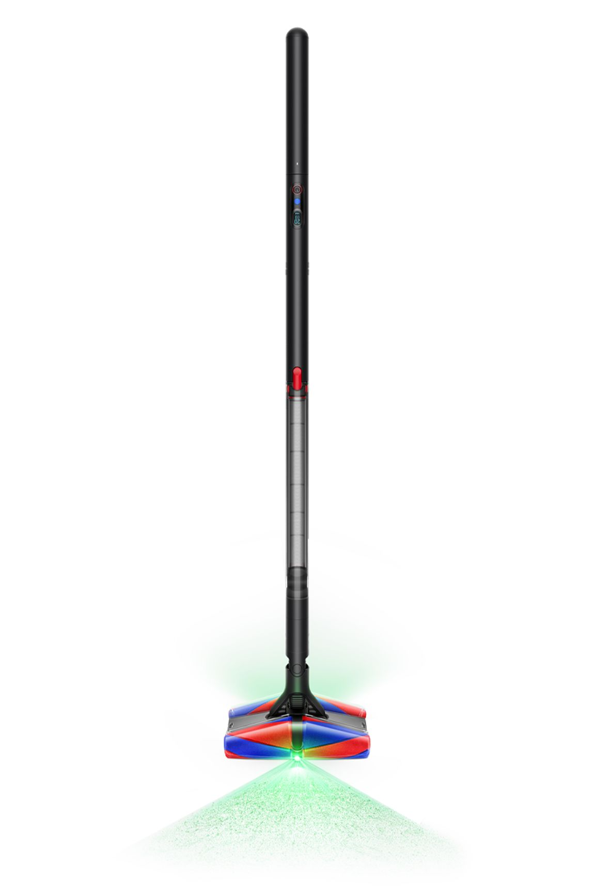
Modern Dyson Design

Slide 12
Dyson built 5,127 prototypes before success

